Slide 1
Systematic Fish Pathology Part 11. Pathology of circulatory / respiratory system – heart, vessels and gills Section A: Heart & Vessels Part II: General pathology, non-infectious and infectious diseases of the heart and vessels
Prepared by Judith Handlinger
With the support of The Fish Health Unit, Animal Health Laboratory, Department Of Primary Industries, Parks, Water and Environment,
Tasmania,
for
The Australian Animal Pathology Standards (AAPSP) program

Slide 2
Course Outline A. Systematic Fish Pathology
1. Consider the Fish: An evolutionary perspective on comparative anatomy and physiology
2. Pathology of the kidney I – interstitial tissue Part A
3. Pathology of the kidney II – interstitial tissue Part B
4. Pathology of the kidney III – the nephron
5. Pathophysiology of the spleen
6. Fish haematology
7. Fish immunology – evolutionary & practical aspects
8. Pathology of the digestive system I – the oesophagus, stomach, & intestines.
9. Pathology of digestive system II – the liver and pancreas, swim bladder, peritoneum.
10. Pathology of fish skin
11. Pathology of circulatory / respiratory system – heart, vessels and gills.
A: Heart & vessels (this presentation)
B: Gills – general & non-infectious pathology
C: Gills – infectious diseases
12. Pathology of the musculoskeletal system and nervous system
13. Pathology of gonads and fry

Slide 3
Acknowledgments & Introduction.
This is the eleventh module of the systematic examination of fish pathology, which aims to convey an approach to diagnosis and cover fish reactions of each organ system rather than to cover all fish diseases, and is based largely on representative pathology found in the diagnostic laboratory of the Tasmanian Department of Primary Industries, Parks, Water & Environment (DPIPWE).
It was funded by the Australian Animal Pathology Standards program with in-kind support of DIPWE as acknowledged previously.
Photos for this series, especially those of gross pathology, are generally also from DPIPWE archives and were generated by multiple contributors within DPIPWE Fish Health Unit.
Contributors of cases from other laboratories have been acknowledged wherever possible and specific material and photographs used with permission where the origin is known. Any inadvertent omissions in this regard are unintended.
References quoted are listed at the end of each presentation.

Slide 4
General pathology & non-infectious disease of heart & vessels
Heart muscle is dynamic, responding with increased effort both to increased demand and to physiological stimuli such as vasoconstriction in the gills (for example, as a response to the chronic irritation of amoebic gill disease). Prolonged increased effort in turn leads to increased muscle growth.
As with other animals, specific nutrients are required to maintain this. Thus as well as species differences, often reflecting swimming effort, the heart varies with age and nutritional status. As gill disease may result in vasoconstriction, it is also influenced by chronic gill disease.
The spongy muscle of both atria and ventricle provides a very large surface area in contact with blood, which is utilised as a bed for reticuloendothelial (RE) cells, which are dispersed between the lining endothelial cells.

Slide 5
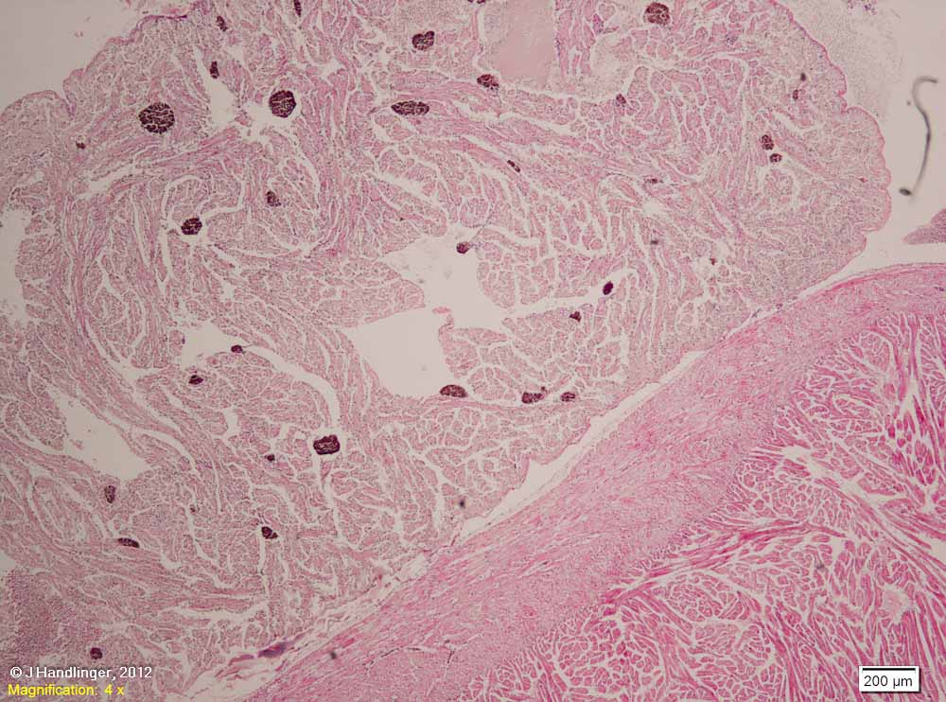
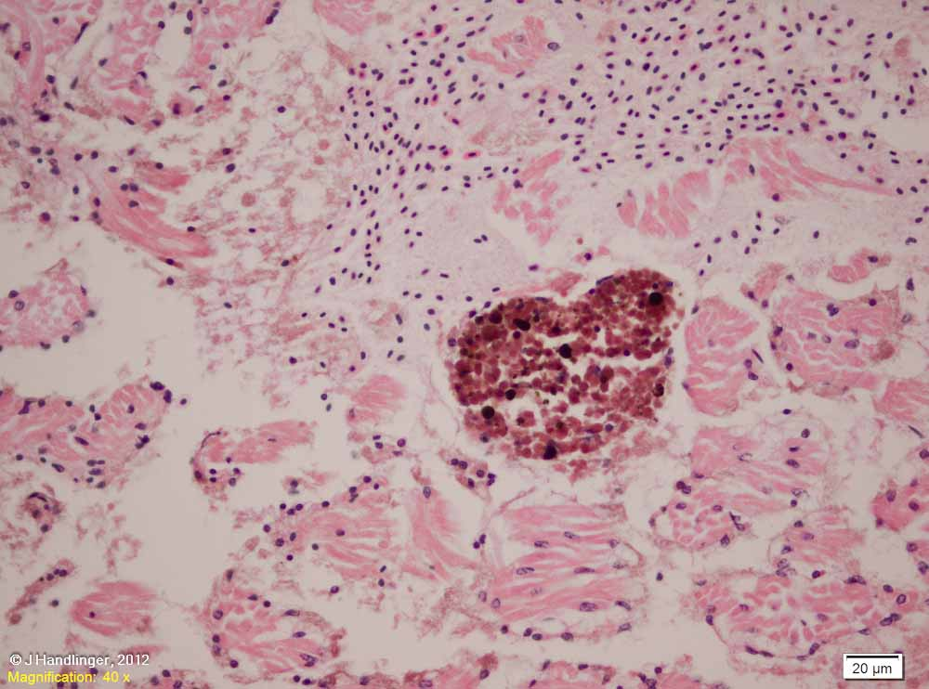
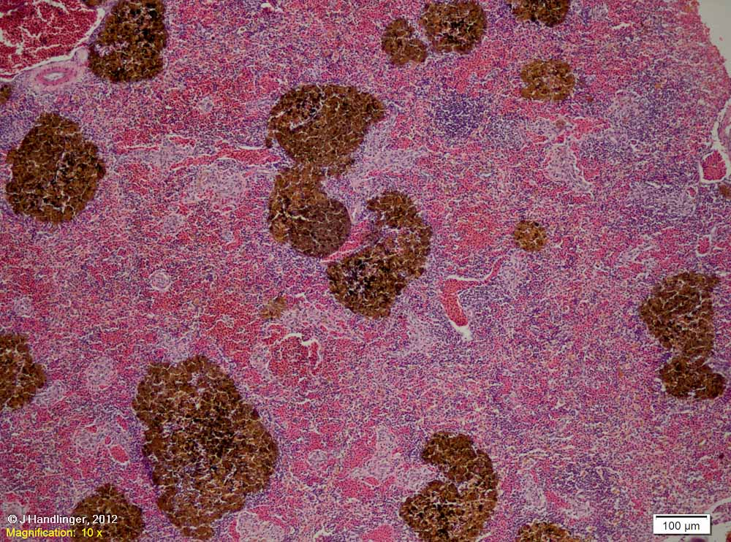
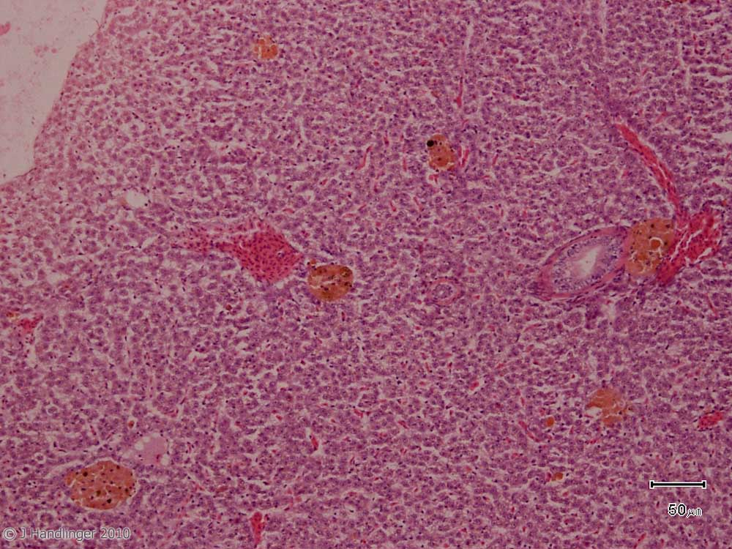
The myocardial trabeculae are lined with endothelial cells, plus a large number of reticular endothelial (R. E.) cells, especially in the thin-walled atrium. [The closest and possibly equivalent bed of R.E. cells in higher vertebrates is found in the liver. Remember this bed is minimal or absent in the liver of fish.] These cells are most obvious in species (such as this 470 g mackerel) that readily form melanomacrophage (mm) centres and have undergone an immune system reaction, in this case possibly to the widespread visceral metazoan parasites. That these increased mm centres are part of a generalized reaction is shown by the spleen & liver of this fish.
ATRIAL REACTIONS
Detail of the melanomacrophage reaction, atrial myocardium, and mixed endothelium / reticulo-endothelium lining.
Spleen from this mackerel, showing that the atrial melanomacrophage reaction is part of a body-wide reaction in sites of with high numbers of reticulo-endothelial cells.
Paler melanomacrophages are present also in the liver of this fish, which had metazoan parasites in the abdominal cavity and putative X-cells in the gills (See Part 12C).

Slide 6
ABNORMALITIES & PLASTICITY OF HEART MUSCLES
There are a number of recognized congenital abnormalities of fish heart including hypoplasia of the septum transversum (resulting in the heart lying directly on the liver), ventricular hypoplasia, abnormal location and shape of heart. Severe abnormalities will not be covered in detail as these seldom thrive enough to survive initial quality culling, and are rarely submitted to a laboratory, unless there is an increased prevalence, but the of the same factors may be involved in milder forms of hyperplasia. (For example, some can be induced by high egg incubation temperatures).
Previously we have seen species variations in heart muscle thickness reflecting the level of effort required for each species, fast predators generally having thicker ventricle walls (stratum compactum) and trabecular areas (stratum spongiosum).
As the heart also responds to increased circulatory effort requirements, there are also within species variations.
Some of these are within normal physiological limits. For example, wild fish generally require more exertion for food capture than pellet fed farmed fish, which can operate with slightly less developed heart muscle. Wild salmon have a distinct triangular pointed heart shape. Farmed fish shape is more variable, sometimes soft & rounded.
A higher incidence of vasoconstrictive gill insults (for example, amoebic gill disease) might, however, counter this reduction in requirement for lower heart work.
Large fish also have a higher requirement / kg for circulatory effort. Overall, therefore, heart thickness usually increases with age.
Nutrition (malnutrition or deficiencies of specific components of which the best known are fatty acids) sometimes limits the response to these stimuli to heart growth.

Slide 7
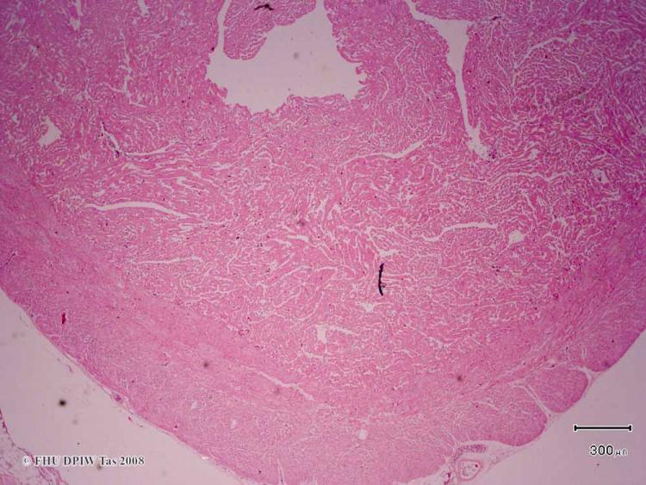
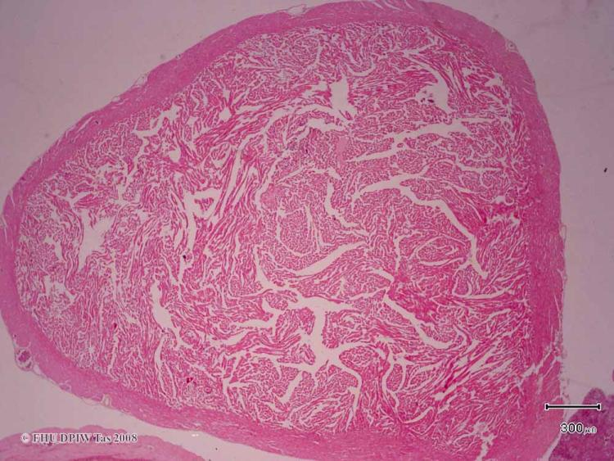
Abnormalities & plasticity of myocardium continued: Two salmonid hearts, sectioned across a similar plane of the heart, showing increased (left) and decreased (right) thickness of both compact and spongy myocardium.
Left – ~ 3 kg triploid salmon, 1 summer at sea, presenting with skin lesions & gill thrombi. Thickening suggests considerable cardiac effort. One contributing factor (given the history) is amoebic gill disease which results in vasoconstriction, leading to higher blood pressures.
Right - Poorly developed heart in a rainbow trout, grown for a similar duration at a slightly more brackish site with no history of amoebic disease. Also with skin lesions.

Slide 8
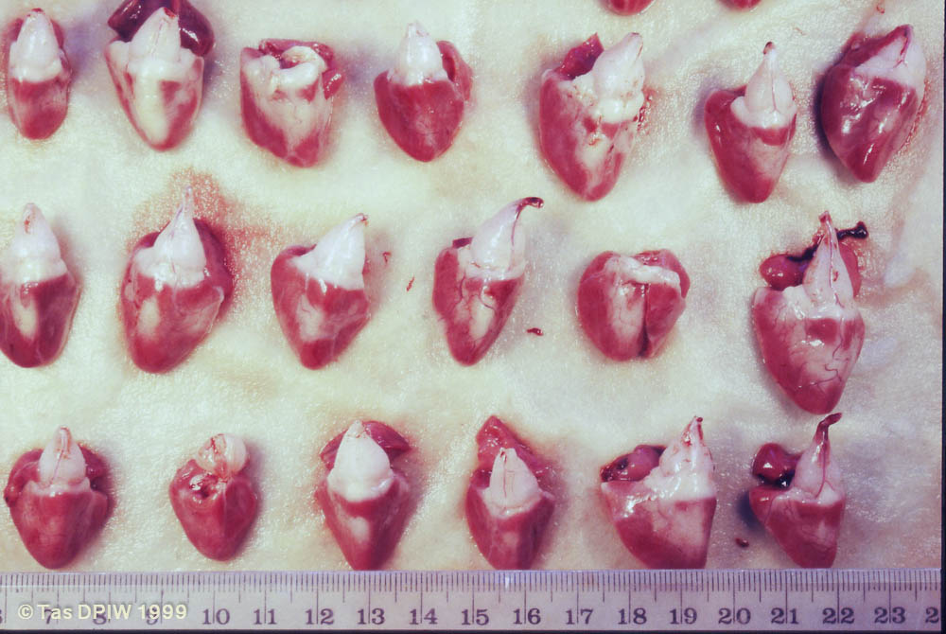
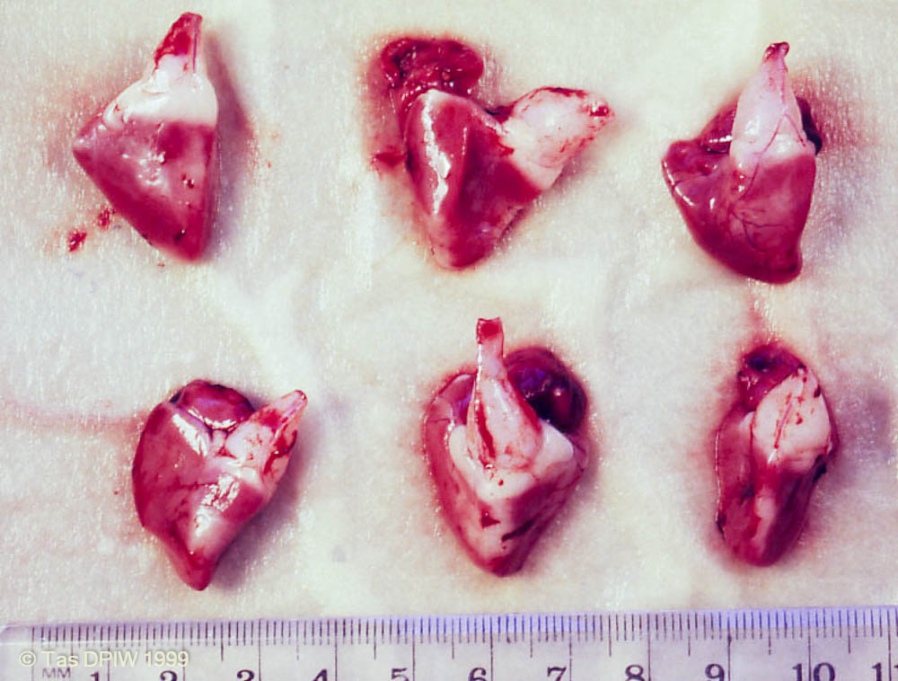
Heart plasticity – gross variations. A cohort of young salmon showing considerable variation in heart shape, reflected histologically by variable myocardial thickening in some fish.
Normal pointed shape
Abnormal rounded shape
A rounded heart can represent either an increase in myocardium, or a lack of tone & a reduced muscle mass. Some of these fish show a flaccid partially collapsed ventricle (arrow) suggesting the latter.

Slide 9
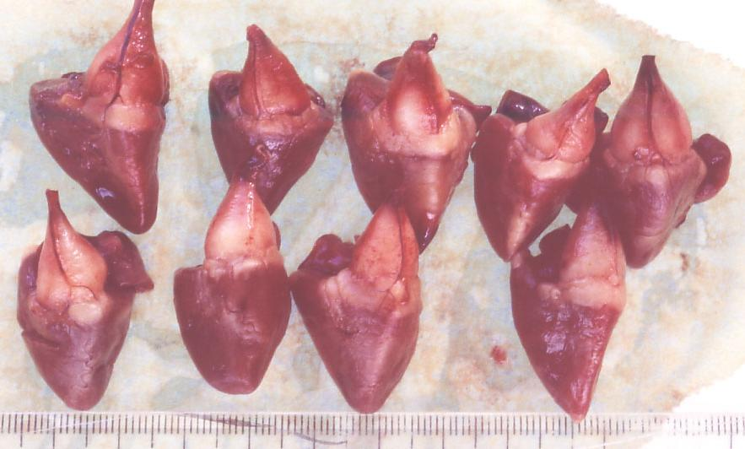
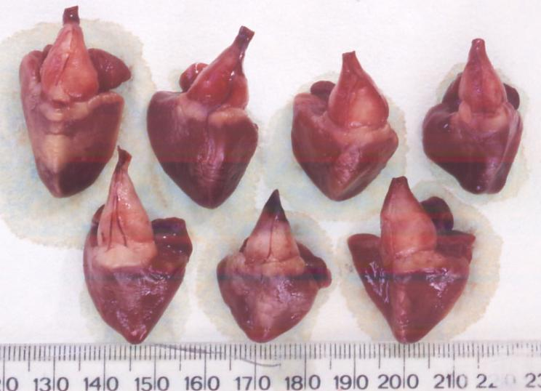
Another cohort (triploid Atlantic salmon showing the normal pointed shape (left, top) or a a more rounded heart shape.

Slide 10
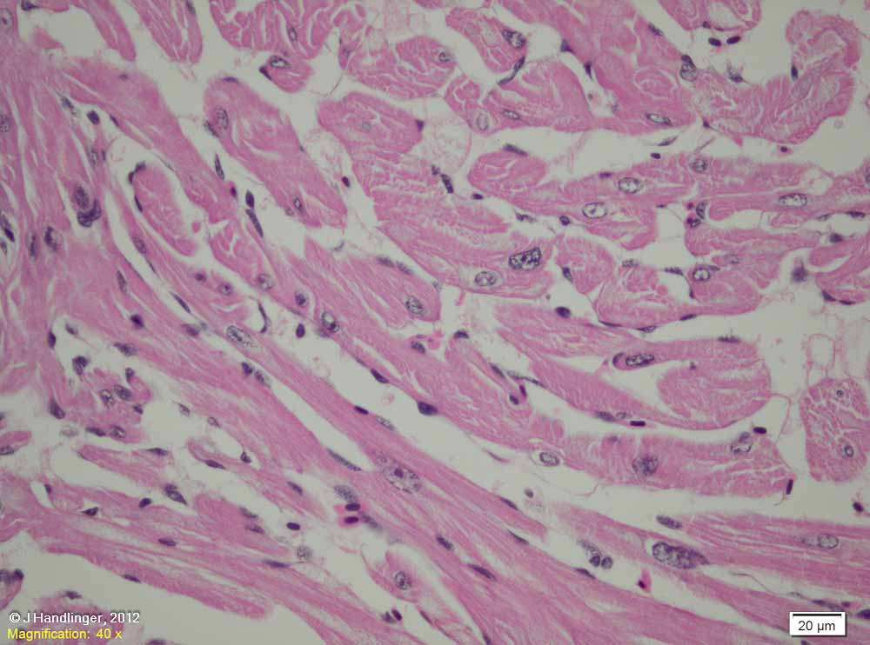
Myocardial variations – histological appearance: One of the key findings during growth (normal or abnormal patterns), is the presence of hypertrophic myocardial nuclei.

Slide 11
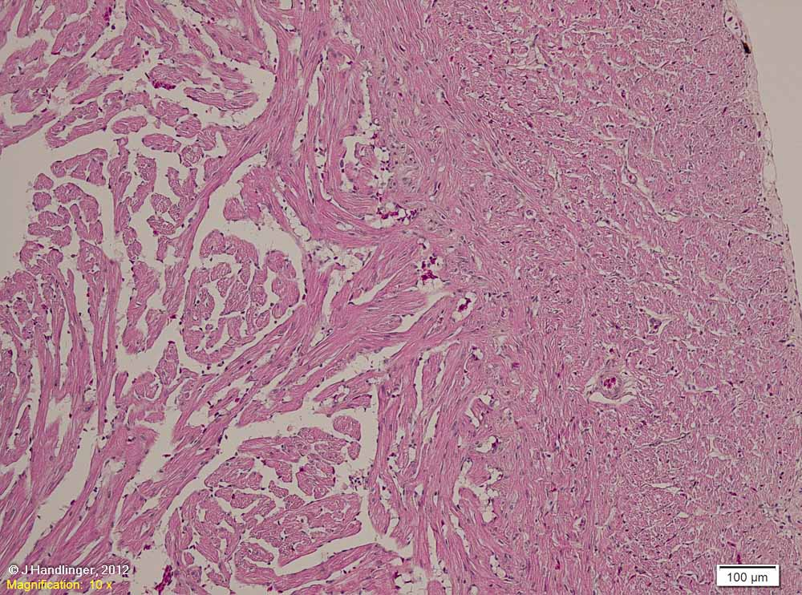
Myocardial variations – histological appearance – a reminder of normal: Compare the following examples of altered heart thickness to this “normal” example of farmed salmon (a second marine year). Note the spaces between the spongiosum trabeculae such that these occupy ~ ½ of these areas, with a relatively even appearance despite the cross-linkage of fibres to give a spongy interlacing meshwork of trabeculae.

Slide 12
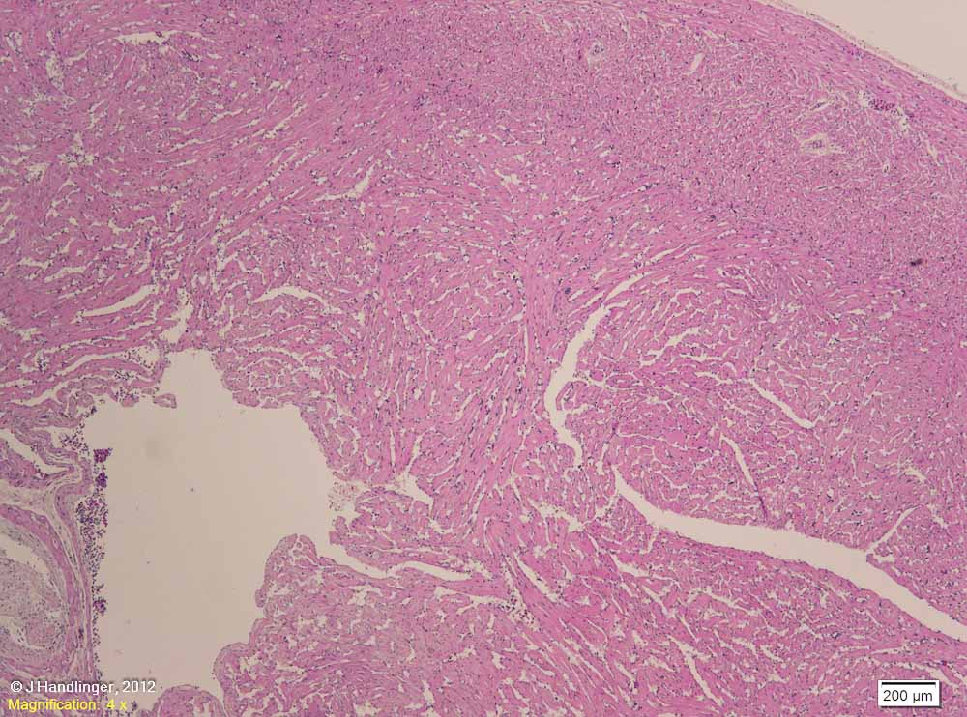
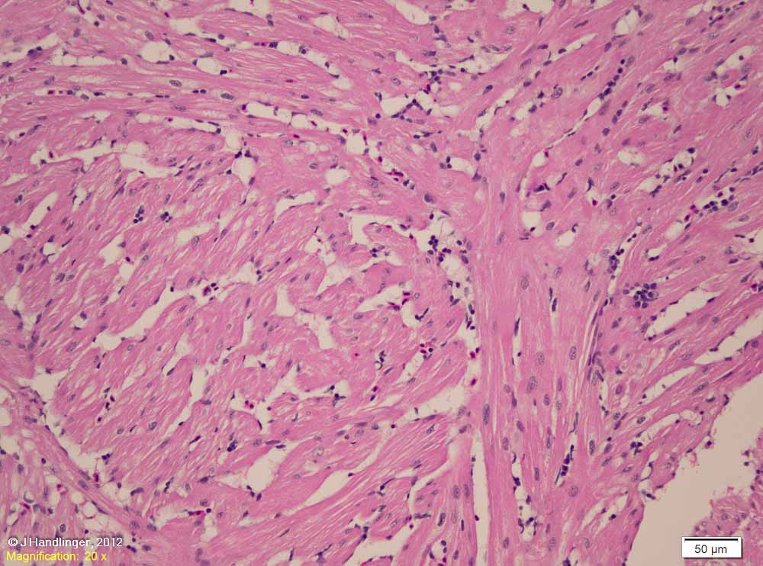
Myocardial variations – histological appearance, thickened (hypertrophic) heart: Compared to the previous slide, there are reduced spaces between the spongiosum trabeculae, which are nearly abutting each other. [Salmon, triploid, history of amoebic & jellyfish related gill disease.]
In this case there is little evidence of overtly hypertrophic nuclei, indicating that this is a long-term rather than rapidly progressing response.
Such hearts were found to be common after chronic exposure to amoebic gill disease (AGD). These clinical / diagnostic findings have been verified by experimental studies which showed changes in heart morphology with chronic heavy amoebic gill disease exposure, which was attributed to a need for elevated heart effort and elevated blood pressure to counter AGD induced gill vasoconstriction .(See Part 12c).
If sufficiently pronounced, hypertrophy may result in reduced heart volume, which can reduce overall heart performance and may be of clinical significance during times of stress that results in an increased circulatory demand.
Wall / stratum compactum

Slide 13
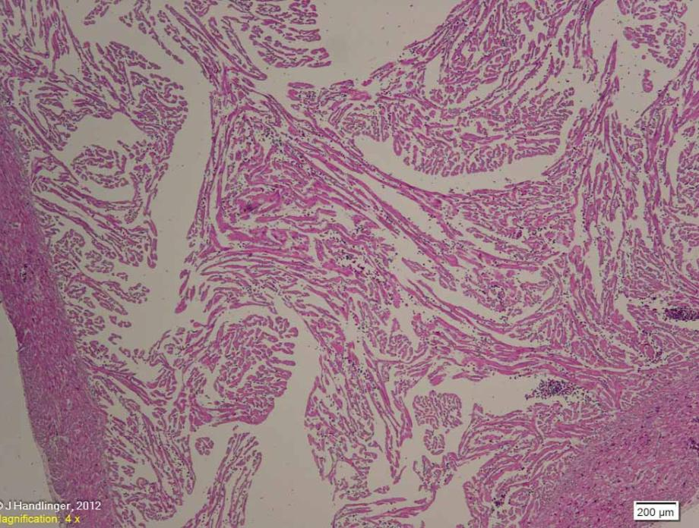
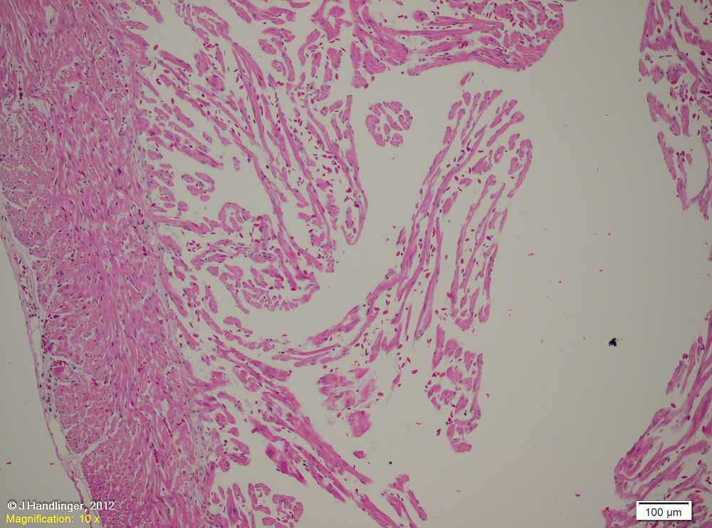
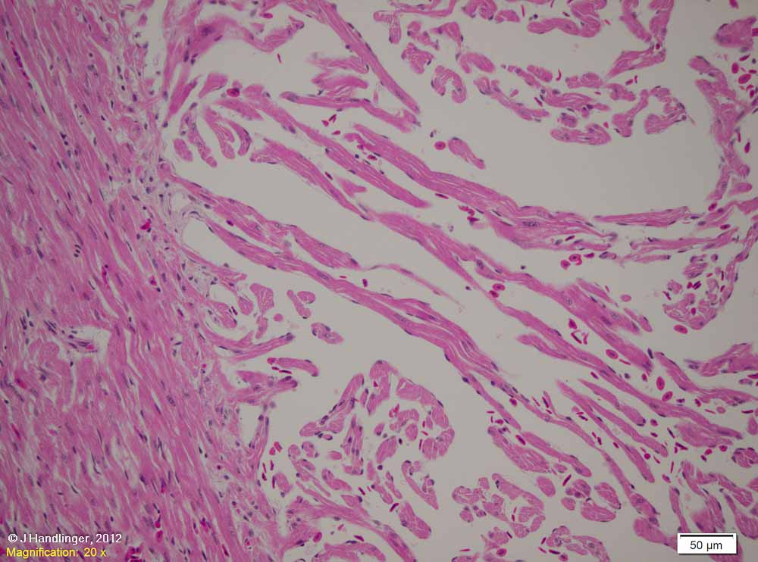
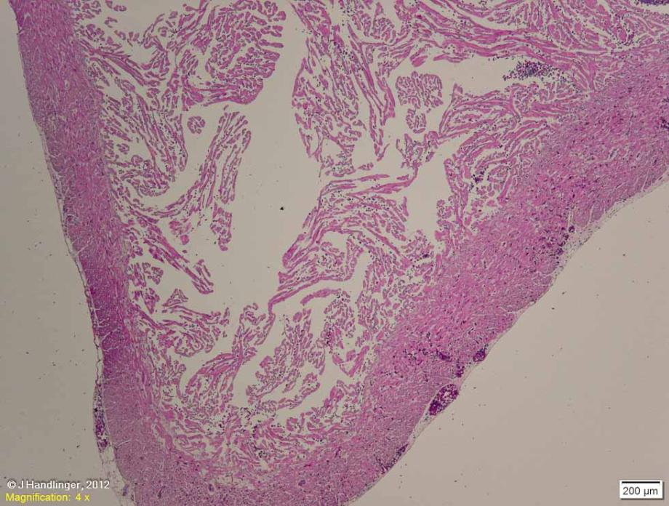
Myocardial variations continued: Composite photo of a 1200 g salmon, harvested from a similar area within a week of the previous fish. This group had on-going low level mortalities. No infectious disease was found, but there was evidence of jelly-fish related gill lesions, and many fish such as this with poor thin ‘raggy’ hearts.
The wall is thin. The trabeculae appear to both occupy less of the lumen (difficult to judge unless a standard area of section is routinely taken), and to show more space between trabeculae within these areas.
The trabeculae are very thin.
Trabeculae are also uneven, with very thin foci, and very low % filling of the stratum spongiosum by the trabeculae. There is little evidence of a growth response (one hypertrophic nucleus in section, arrow). Note too the slight increase in paler connective tissue (endocardiosis) at the compact:spongy junction (blue arrow).
Similar changes have been seen in batches of fish in Norway, where varying levels of ventricular hypoplasia (sometimes so severe as to result in negligible stratum compactum). High egg incubation temperature was identified as a possible aetiology in those populations (Poppe & Taksdal, 2000). Poor growth at other early stages of development is also suspect.
The on-going low level mortality in these fish appears to reflect inability to cope with the increased circulatory demand of acute stress, such as the jellyfish identified near cages. These poorly developed hearts would need to respond both to increased cardiac demand associated with stress, and possibly an increased vascular resistance resulting from a local gill vasoconstrictive response to gill damage.
[Farmed fish are generally protected from most sudden increases in cardiac demand, compared with wild predator / prey fish, so they survive until stress or illness markedly increases cardiac demand.]

Slide 14
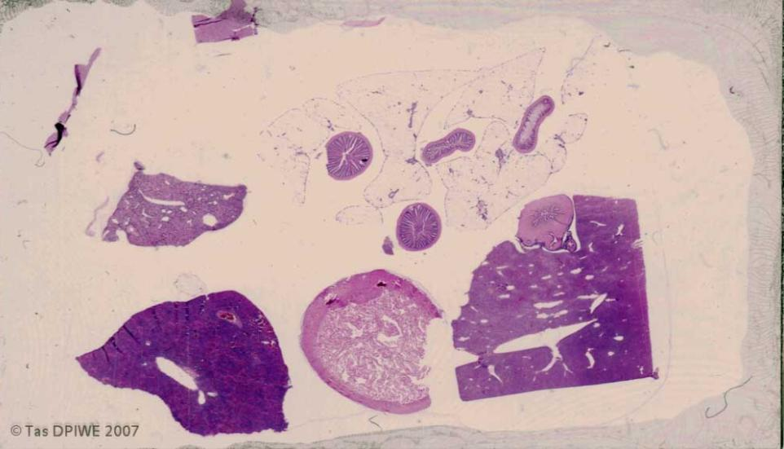
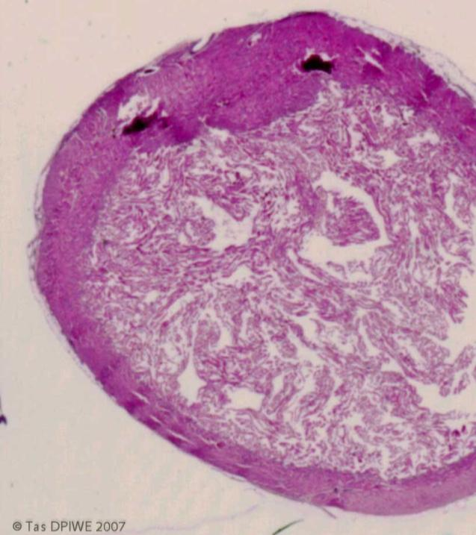
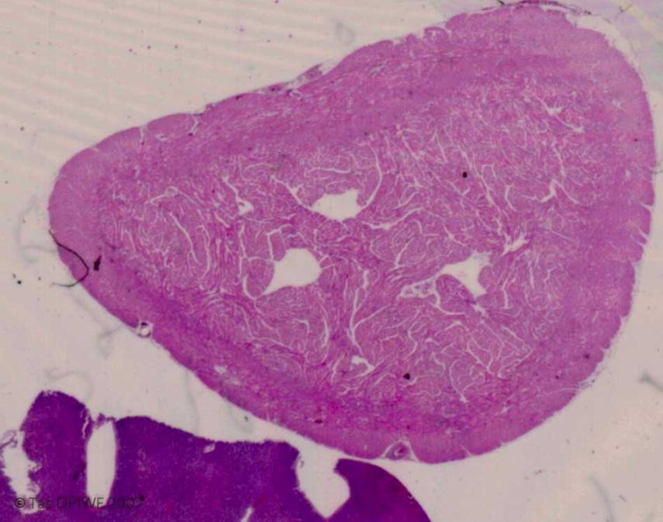
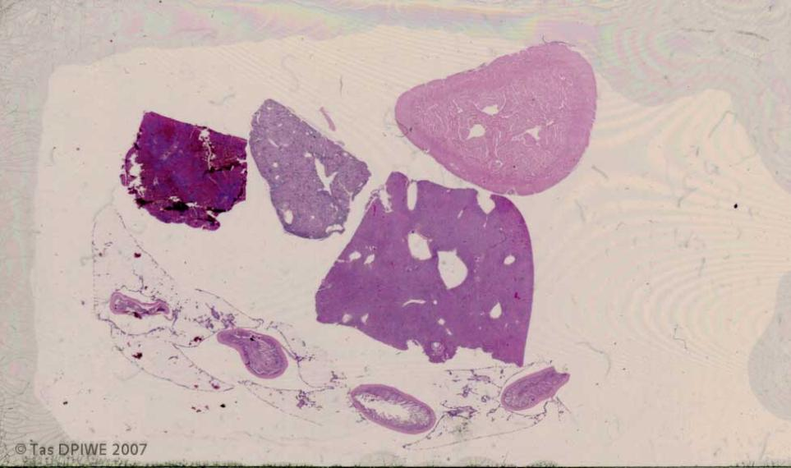
NUTRITION & HEART DISEASE
Two scanned slides of multiple organs from two fish fed high (top section) and moderate (bottom) levels of an unbalanced fat source.
The feed trial was terminated early due to a high level of mortalities (in both groups, but particularly the high fat group), which were related to jellyfish stings & related stresses. The mortality was higher in these cages, though the level of exposure was similar across intervening normal-fed tanks. (That is, these fish were unable to cope with this stress.)
Marked thinning of the myocardium (especially the spongiosum) is visible in the upper section.

Slide 15
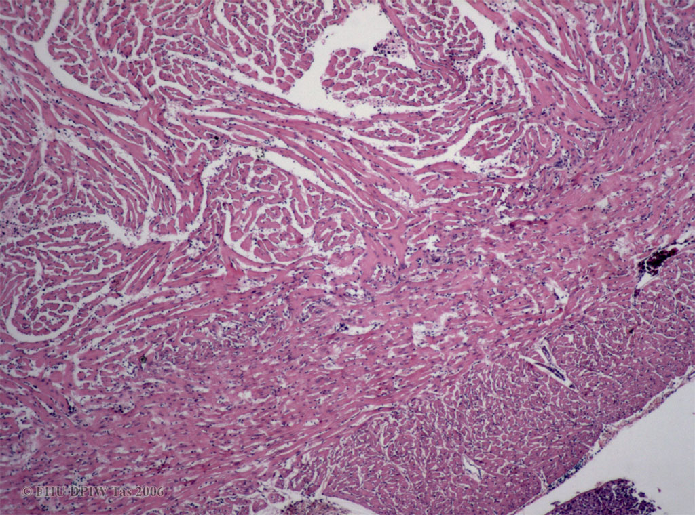
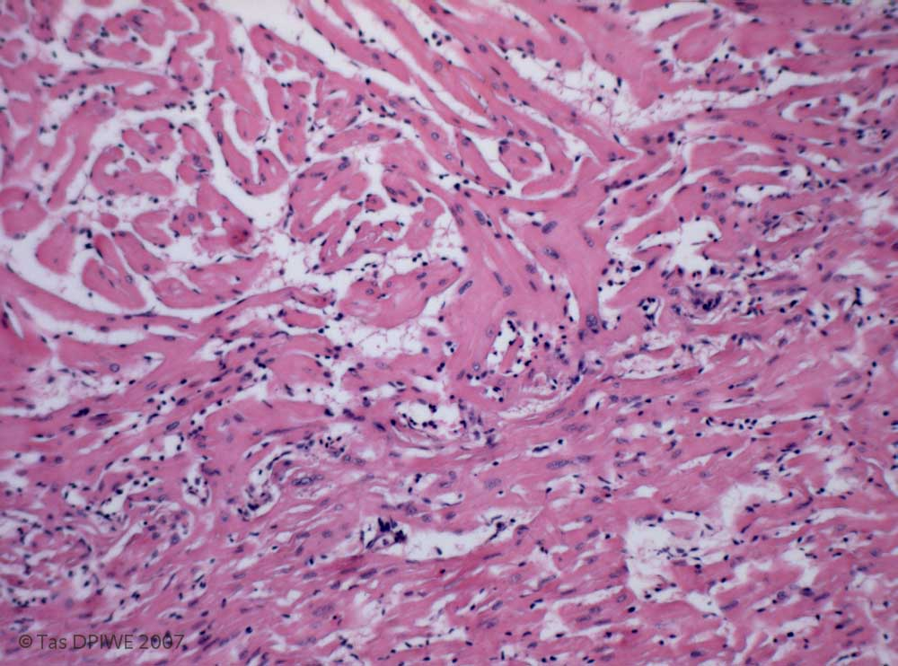
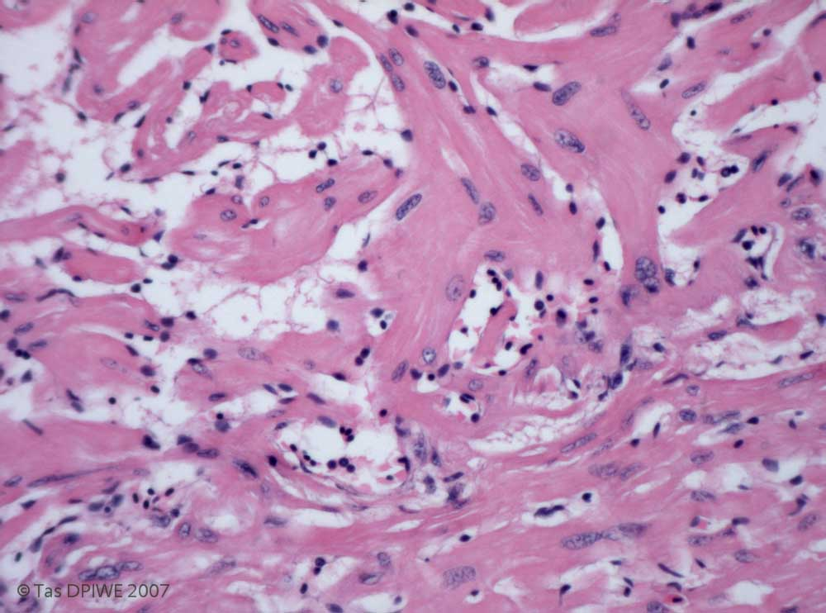
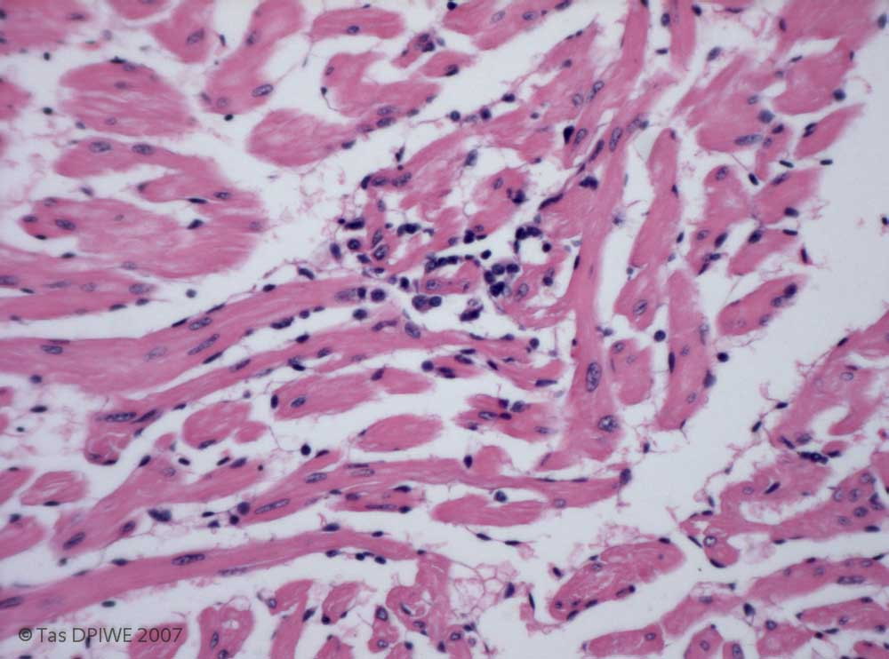
Section from the fish with the lower level of unbalanced fat, showing that although both muscle components appear quite dense, scattered areas of increased cellularity (inflammation) are present, mainly along the junction of two zones (arrows). [x 4 objective]
Areas of hypertrophic nuclei and thick trabeculae are present. [x 10 objective]
..together with foci of degeneration (arrow) , possibly including some myocytes as well as apparent lysed erythrocytes (implying a small localized clot). [x 20 objective]
..plus small foci of reaction (presumably to the degenerate cells). [x 20 objective]
Overall the trabecular size was reduced also in this group (especially relative to body size, overall growth not being affected), but not to the extent of the high fat group.

Slide 16
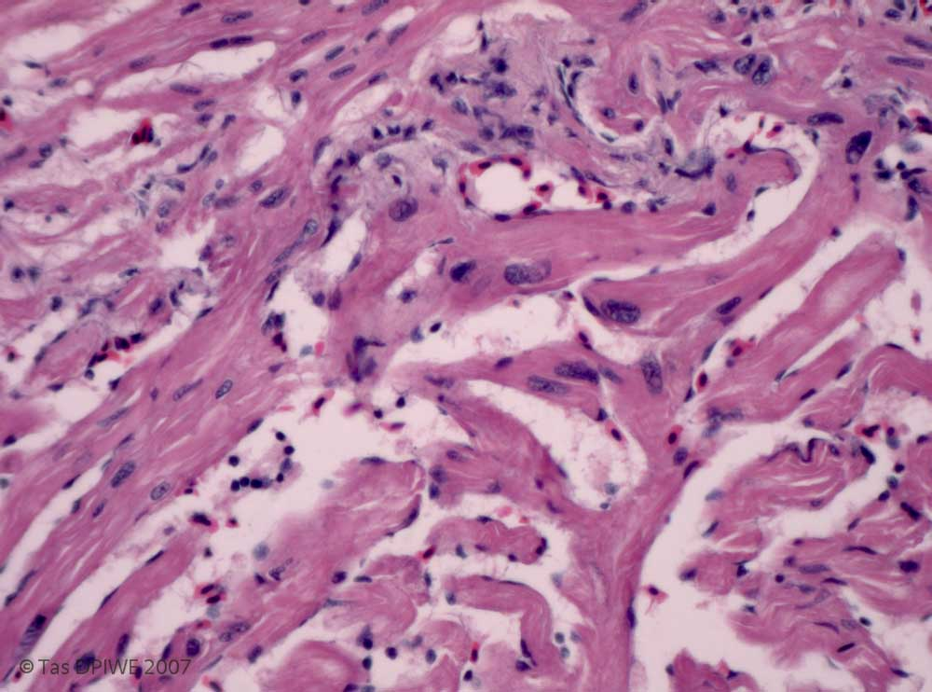
Note the focus of increased connective tissue, as well as hypertrophic nuclei, at the junctional zone. Other changes include foaminess of plasma (usually most obvious at the junction), streaky myocardial pallor (arrow), and reduction in the size of myofibres in the adjacent compact muscle (at left), leaving increased pale spaces between adjacent cells. [x 20 objective]

Slide 17
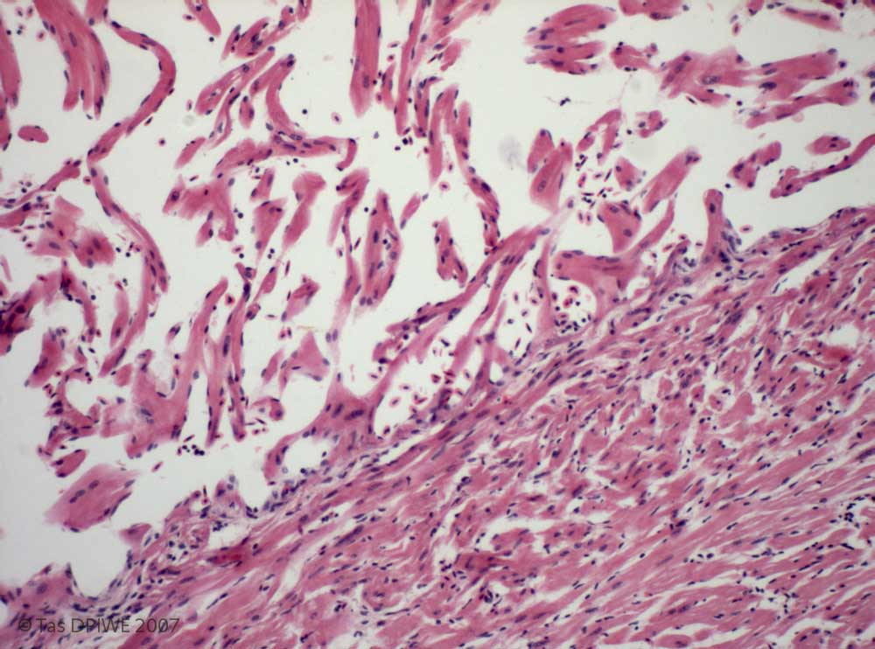
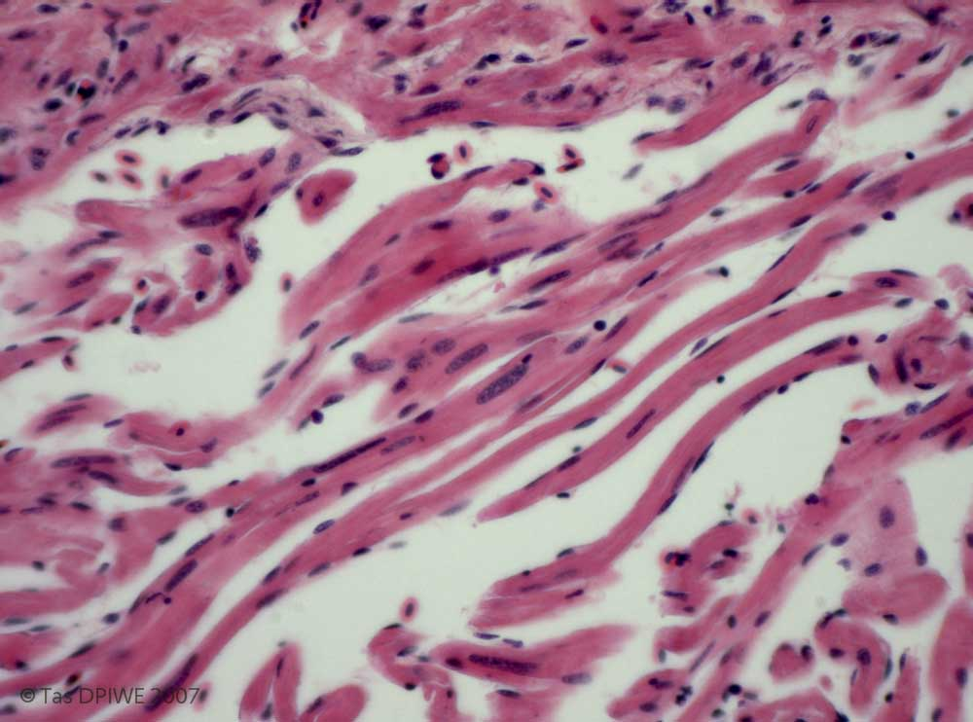
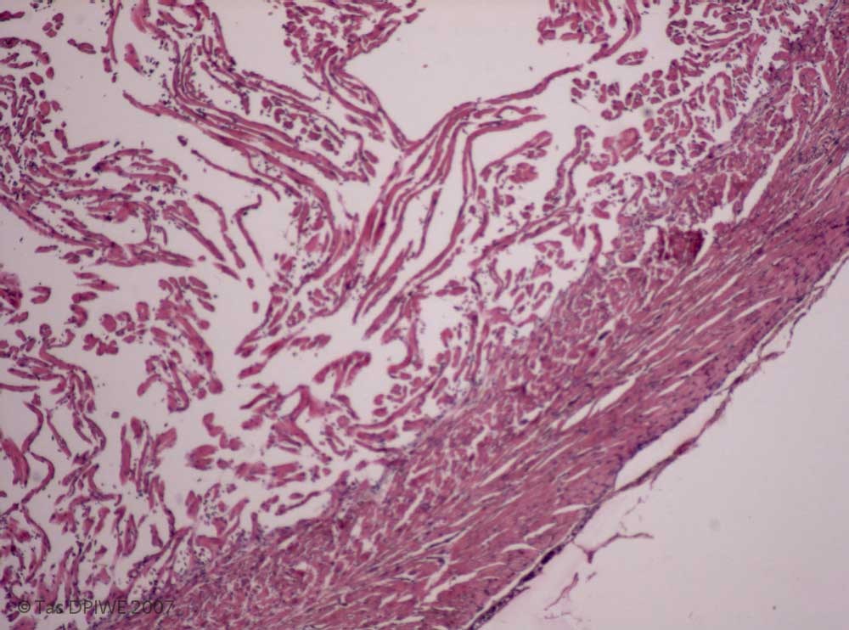
Section from the fish (above scan) fed with the highest level of unbalanced fat, for ~ 4 months. Trabeculae in the spongy muscle layer are very thin. Compact muscle fibres also appear thinned, with increased visible spaces between. [x 4 objective]
Detail from an area which does show hypertrophic nuclei (arrows), indicating that although the heart is very poor, there is an attempt at regeneration, though it is likely that degeneration will outstrip this while the dietary imbalance remains.
Detail of the junction area. Inflammation and degeneration is less obvious, but all muscle fibres are markedly thin, with little hypertrophy and some small condensed nuclei in the compact muscle. [x 10 objective]
Although the exact fat composition is not available, the lesions closely resemble the focal necrosis and myofibre thinning described by Bell et al, 1991, in Atlantic salmon fed a diet high in linoleic acid (in their case from sunflower oil which is high in n-6 fats). Normally adequate n-3 fats, the polyunsaturated fatty acids (PUFA) were included. Like these fish, those on the sunflower oil diet were highly susceptible to stresses, with 30% mortality following transport.
Normally, freshwater fish including rainbow trout can metabolise linoleic acid by desaturation to gammalinoleic acid which can then undergo elongation through to arachidonic acid. Many marine fish are deficient in at least some of the required enzymes. This applied also to Atlantic salmon during smoltification, but not during the post-smolt seawater phase, under normal dietary conditions. The high linoleic levels altered the ratio of n-6:n-3 fats, resulting in a deficiency of the latter & heart lesions such as these.
Other effects of nutrition on heart pathology include an increase in coronary arteriosclerosis with rapeseed oil, compared to fish oil alone (Seierstad et al, 2005); and myonecrosis of cardiac & / or skeletal muscle with selenium deficiency, as in mammals. [However most fish meal based diets are likely to be high in selenium.]

Slide 18
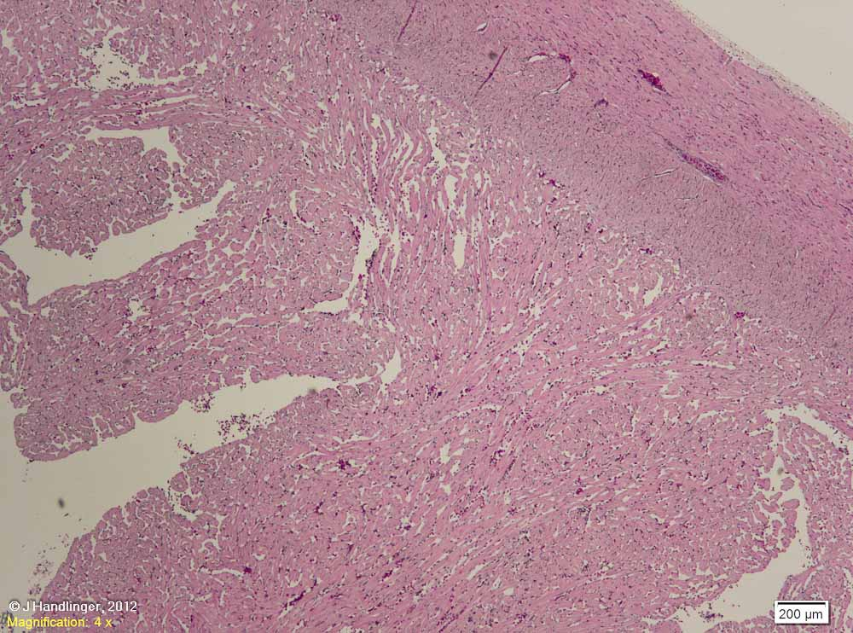
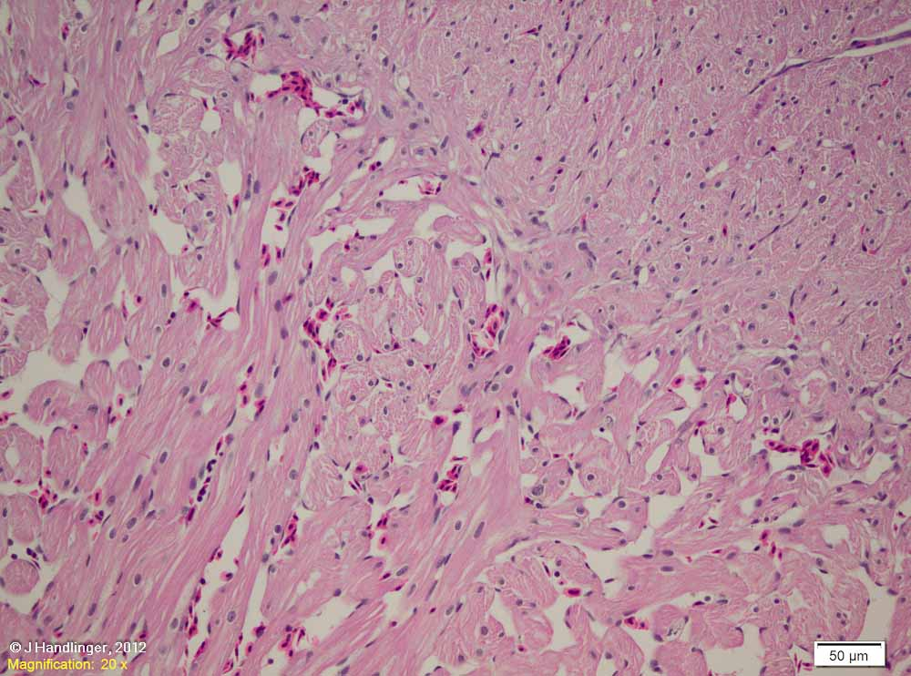
Myocardial alterations – globules within myocardial cells: Not all findings are fully identified. This heart is from a group of ~3.5 kg female salmon investigated for thickened & fatty hearts.
Most fish showed thickened hearts with ill defined areas of intracellular pallor, and occasional hypertrophic nuclei. There was a moderate increase in pericardial fat, and livers also showed a variable fat increase.
These findings suggested a heart effort stimulus, such as the vasoconstriction shown with amoebic gill disease (AGD), plus a dietary fat component.

Slide 19
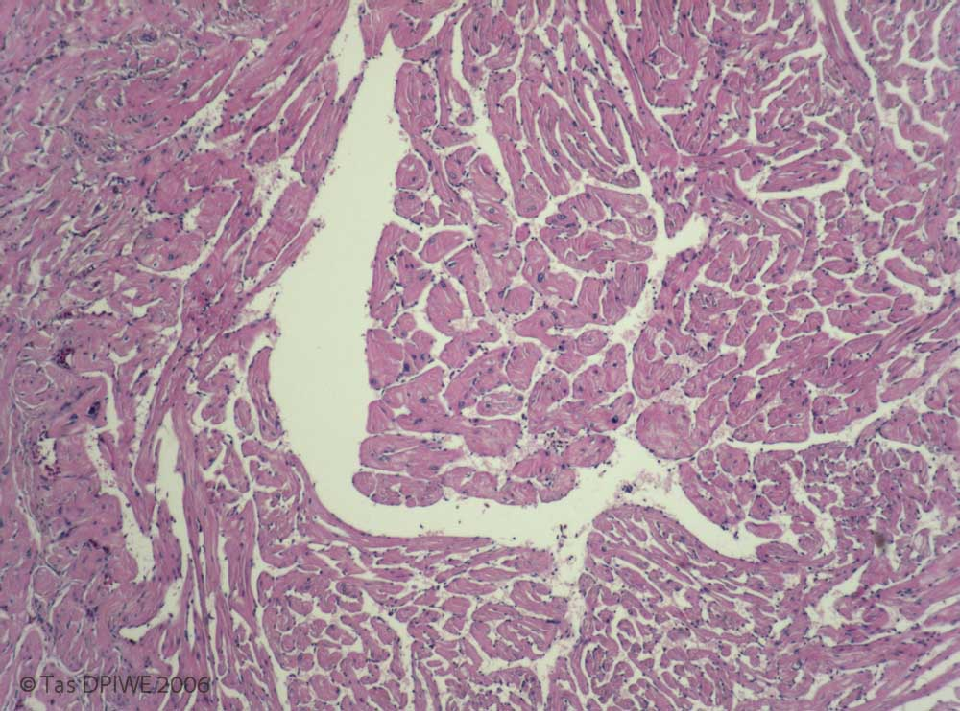
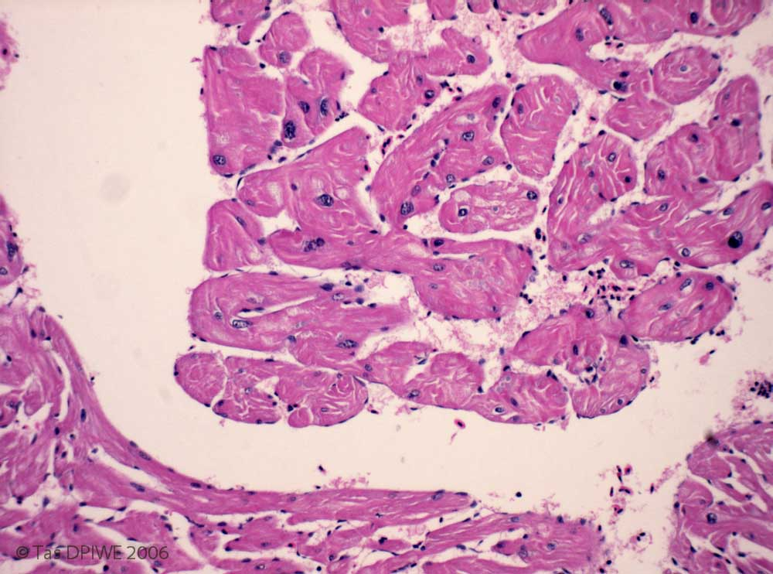
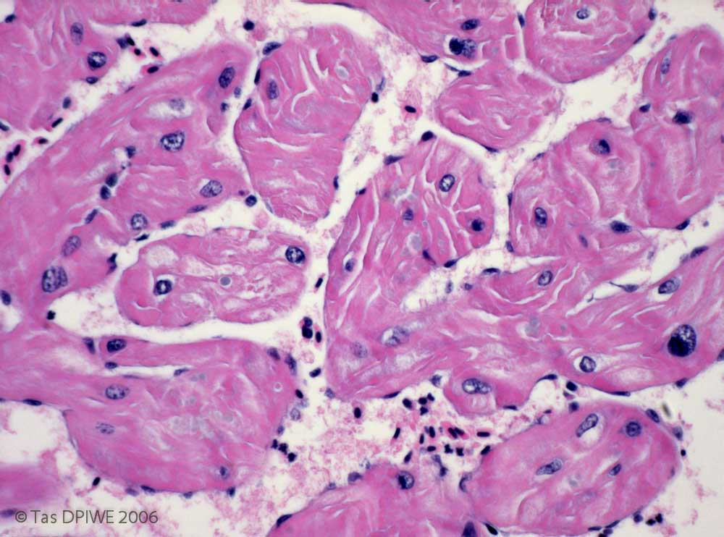
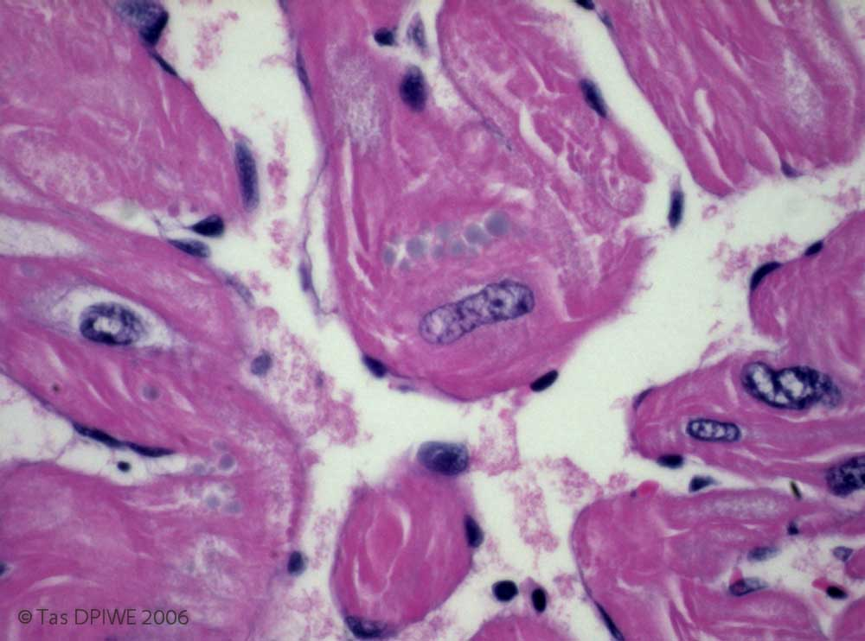
One of these fish showed a much higher level of nuclear hypertrophy, especially at the junctional zone (left of photo). [x4 objective mag.]
Areas of pallor in myocytes were more marked, and sometimes contained pale grey globules (arrows). [x10 objective mag.]
Note the other area of pallor. [x40 objective mag.]

Slide 20
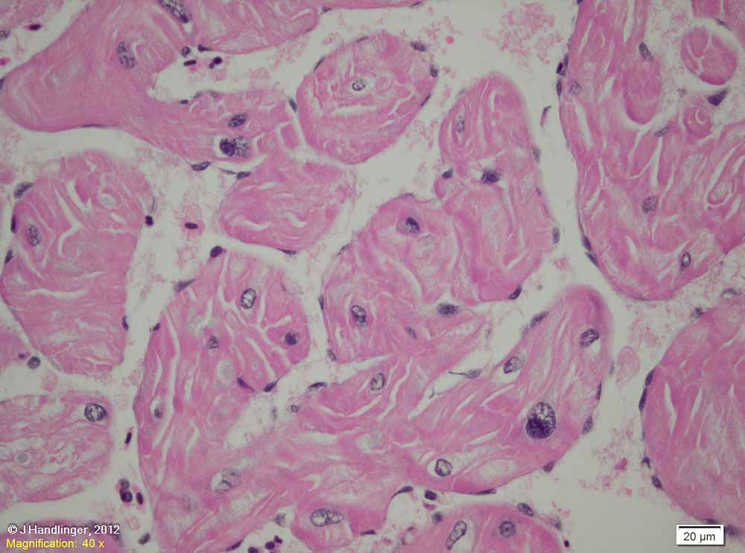
Another area, showing the streaky pattern of pallor, and globules.

Slide 21
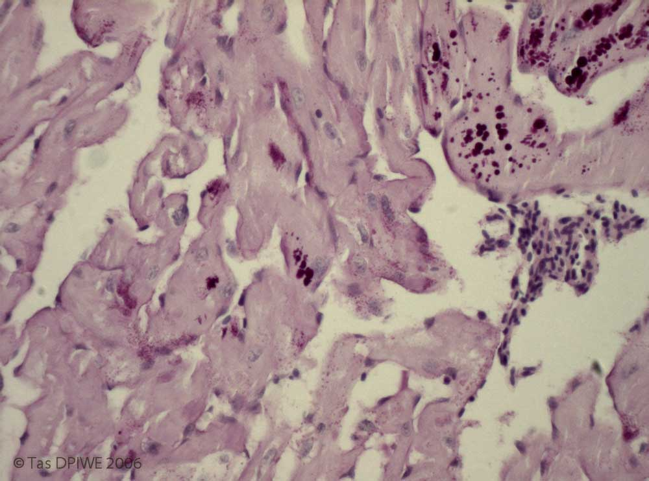
The globules were PAS positive, as were some of the areas of finer pallor, indicating these represent a substance with a polysaccharide component. [x20 objective mag.]
The material was not positively identified, but given the history & staining characteristics, likely possibilities include glycogen (which is usually washed out during processing, and eosinophilic in H&E if they remain), glycoproteins, glycolipids and other mucosubstances . Glycolipids can be important in energy metabolism, but no reference was found for a role in fish hearts.

Slide 22
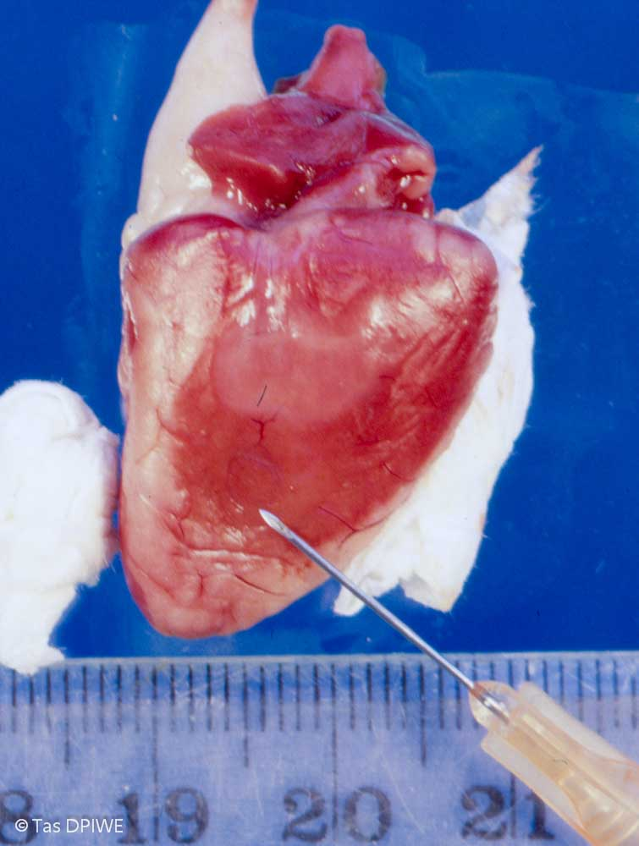
PATHOLOGY & CORONARY VESSELS
Arteriosclerosis of the coronary artery is present in most spawning wild Pacific & Atlantic salmonids, & in farmed salmonids but is not seen in other fish.
Such vessels are partially occluded by a proliferation of vascular smooth muscle following disruption of the basal lamina, supposedly due to overstretching of the vessel on the highly distendible bulbus. There is no calcification or fat plaque. Resulting clinical disease is unproven (i.e resting salmonids can survive ligation of the coronary artery). (Reviewed Farrell, 2002).
Myocardial necrosis following transport stress in harvest fish, suspected to be due to these partial occlusions ,has been described by Poppe et al, 2007.
The depressed myocardial defect in the salmon heart shown at right is suggestive of a post-infact like lesion, though a congenital defect or prior bacterial infection cannot be excluded.

Slide 23
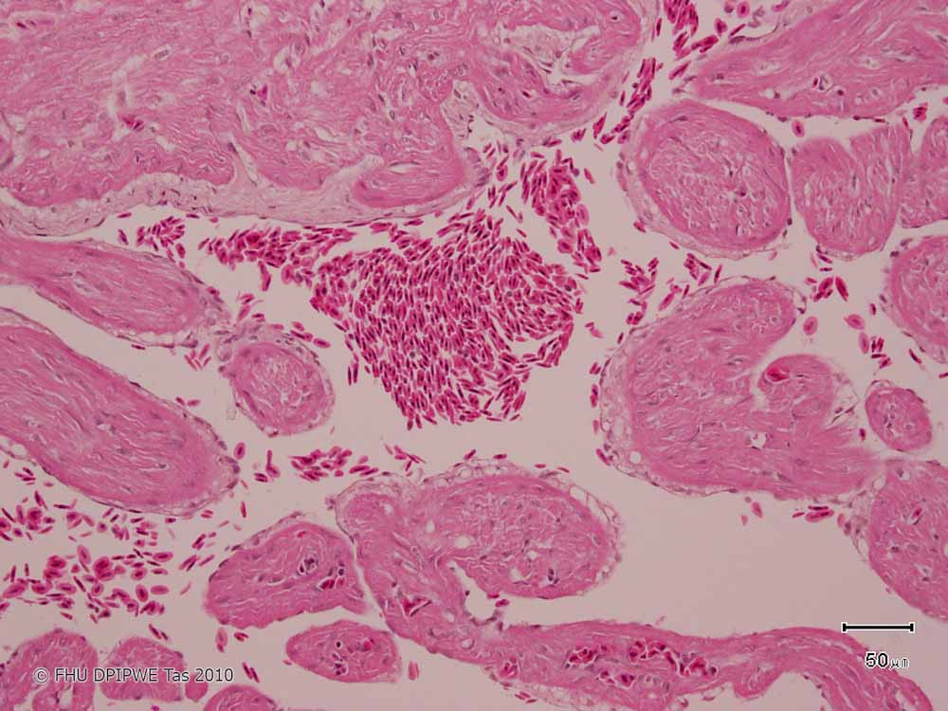
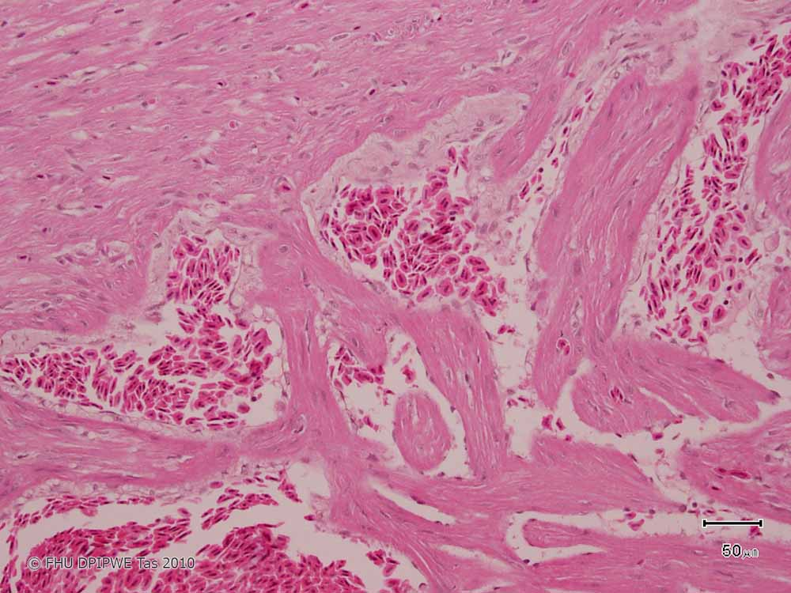
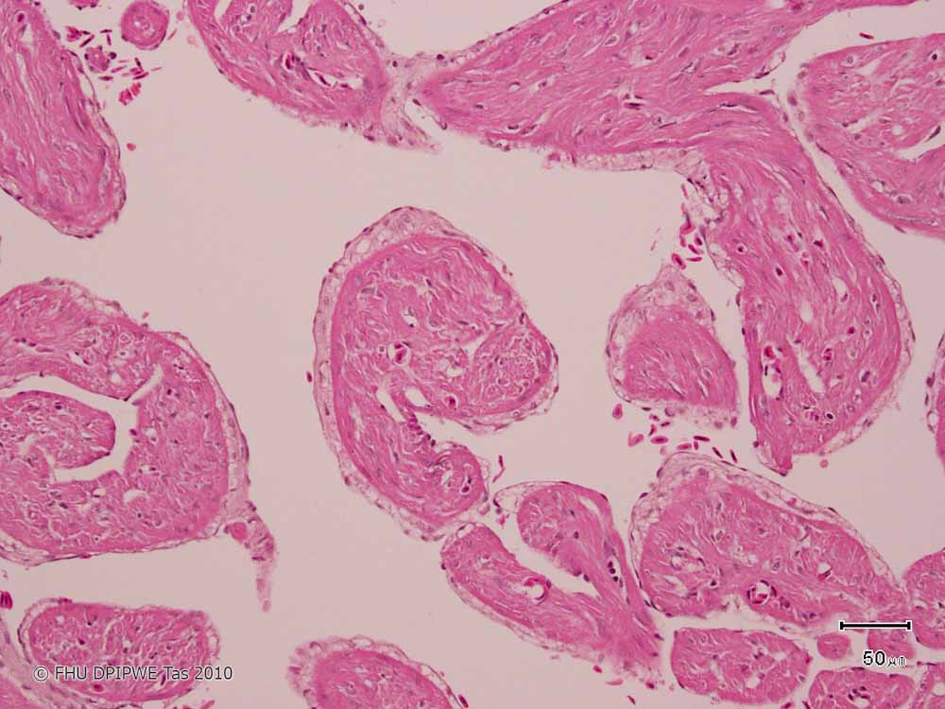
ENDOCARDIAL REACTIONS
Case 1: The endocardium near the compact: spongy junction of this 3-4 kg rainbow trout shows ballooning of endocardial cells on trabeculae (white arrow).
.. And an area with fibrous tissue lining trabeculae near the junction, with few vacuoles.
It seems likely that the fibrosis follows surface injury, but it is unclear if this is related to the more acute vacuolation of surface cells. The fibrosis (the main subject of this slide) is unlikely to be of sufficient severity to have clinical significance in terms of heart function, and the cause was not determined.
The cause of the more acute endothelial vacuolation is also uncertain. However it may be significant that this unusual change was seen in a fish that was moribund when sampled as part of a routine health check, from a population from a brackish water zone subject to occasional increases in water borne copper levels during periods of local river flushing, and where moribund cohorts showed variable chemical and histological evidence of exposure to water borne copper.
Evidence suggesting copper exposure included variable, sometimes elevated gill copper levels; loss of neuromasts and spongy epithelial degeneration of the lateral line; and severe “ballooning” vacuolation of hepatocytes in some fish that resembled those seen during copper exposure trials in brackish water (see Part 9B). Therefore copper toxicity cannot be excluded.
Copper affects a wide range of functions, typically those of the gill first from water borne exposure, though brackish water minimizes the resulting ionic changes. The high levels of cytochrome p450 of fish myocardium (Ferguson, 2006, p144) implies these cells may share some similarity in vulnerabilities to hepatocytes to this toxin.
An area with more obvious junctional fibrous tissue.
This appears to be an acute change, but if so may reflect an on-going process as there is also a significant increase in connective tissue at the junction region (blue arrow).

Slide 24
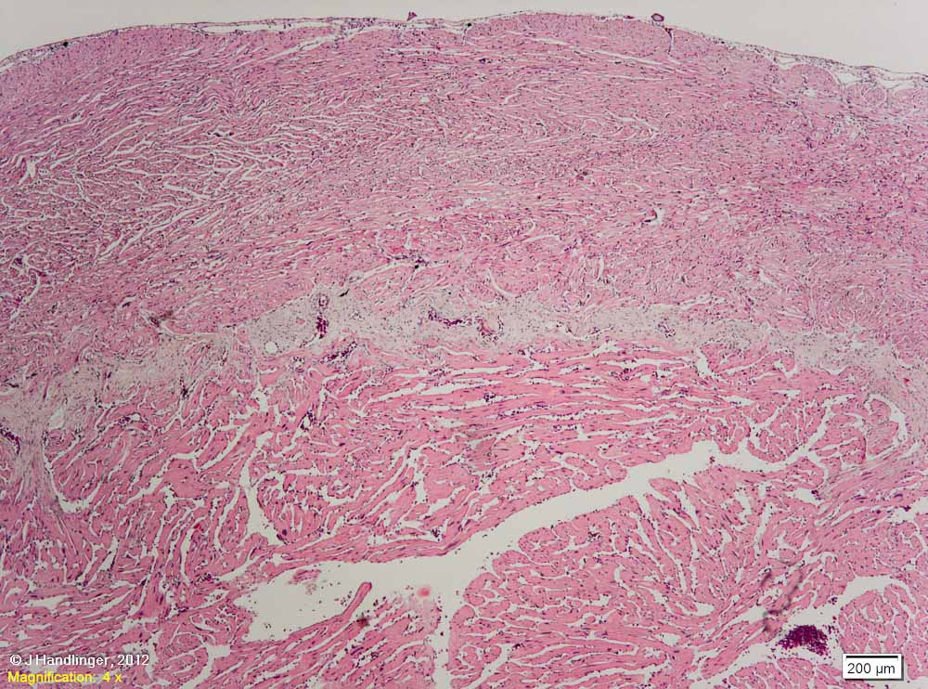
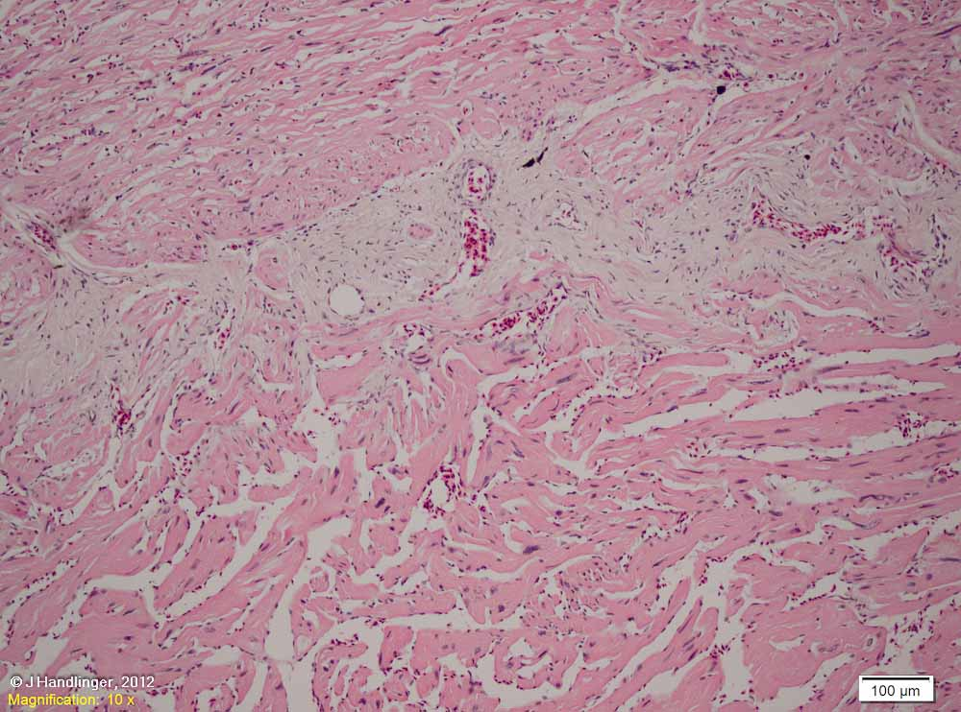
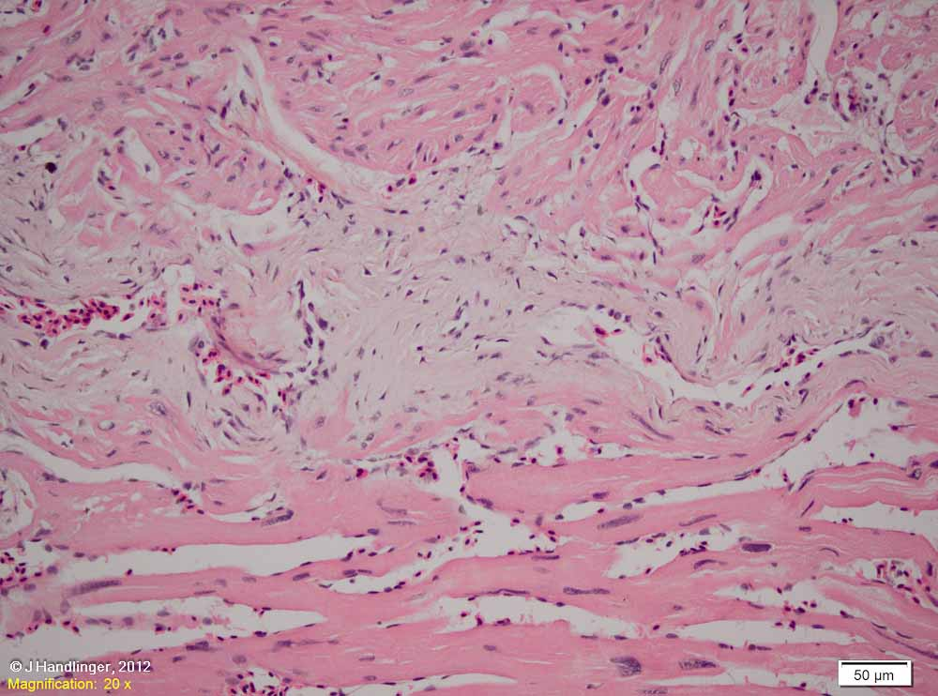
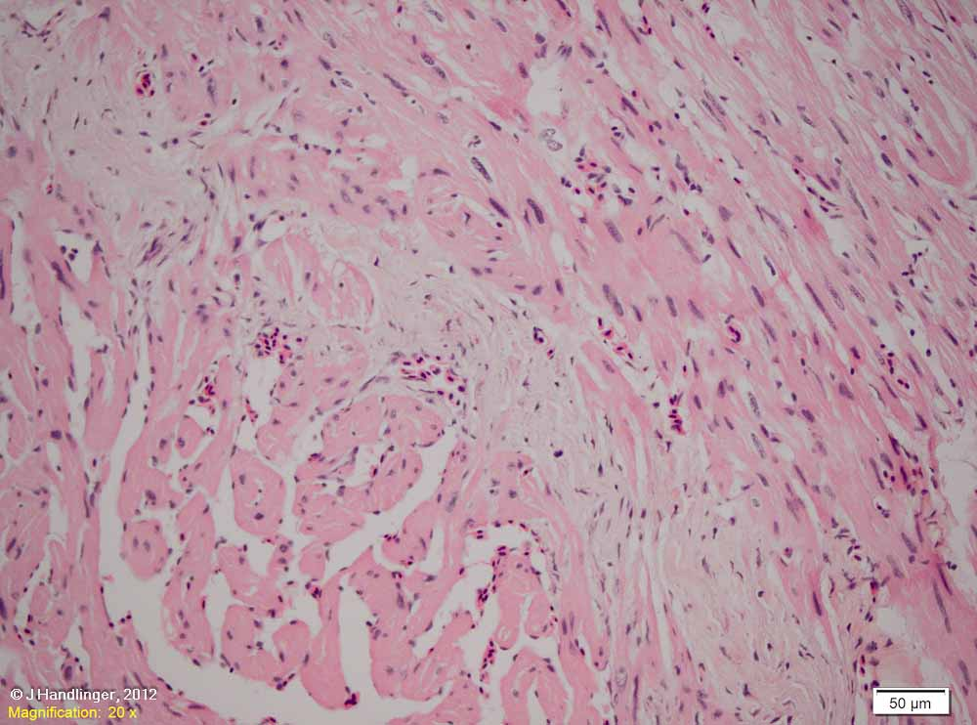
Endocardium Case 2 – constrictive myopathy: In this 1 kg salmon, fibrosis of the endocardium at the compact: spongy junction is much more marked. (white arrows).
Fibrosis appears to be replacing some trabeculae.
There is fibre thinning and wavy fibres in the adjacent compact muscle, and scattered hypertrophic nuclei in nearby trabeculae.
Showing pallor & thinning of compact muscle (right).

Slide 25
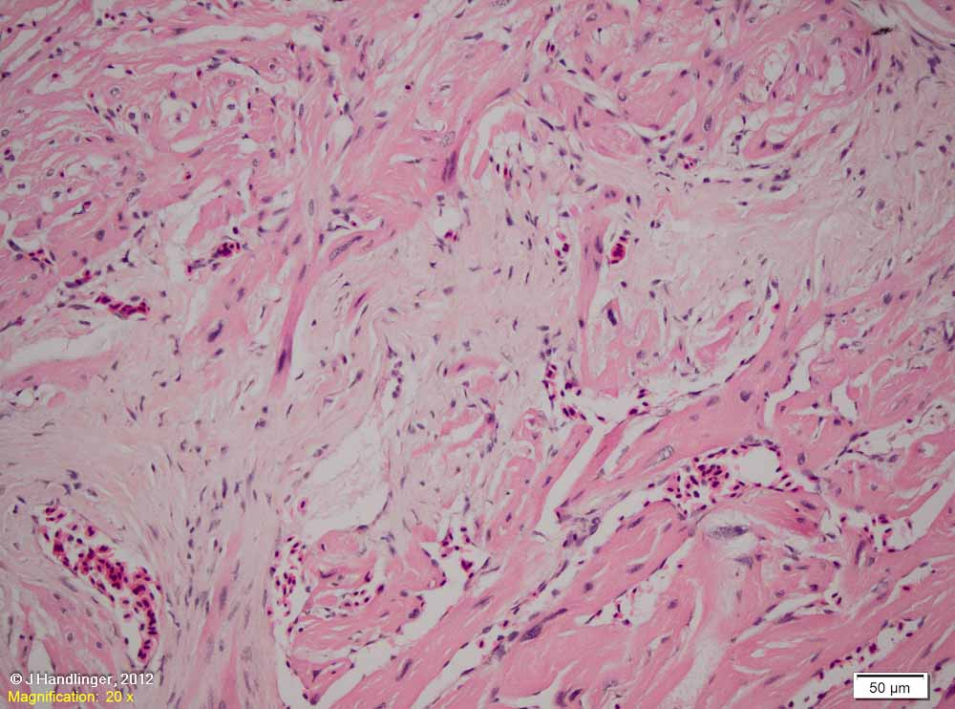
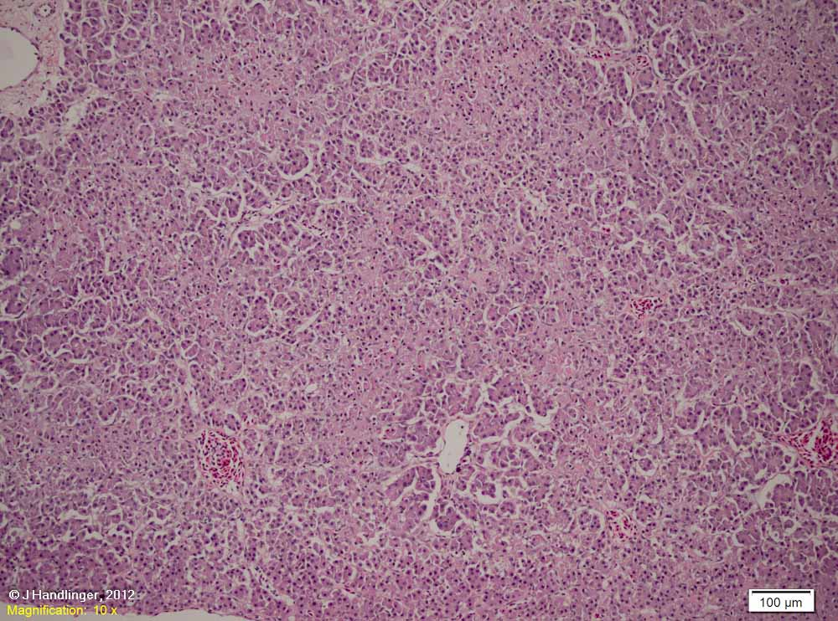
Same section, showing individual muscle fibres apparently undergoing necrosis due to constriction, with fibrous tissue apparently originating round cardiac vessels and indicating that regardless of the initial cause, the lesion is at this stage probably progressive.
This lesion was of clinical significance in that it was associated with abnormal heart shape, and there was peritoneal serositis and zone-related liver changes, as well as acute skin lesions (no significant bacterial findings).
Liver from this fish – zone related changes, compounded by autolysis (which alone does not usually show such a zone related pattern).

Slide 26
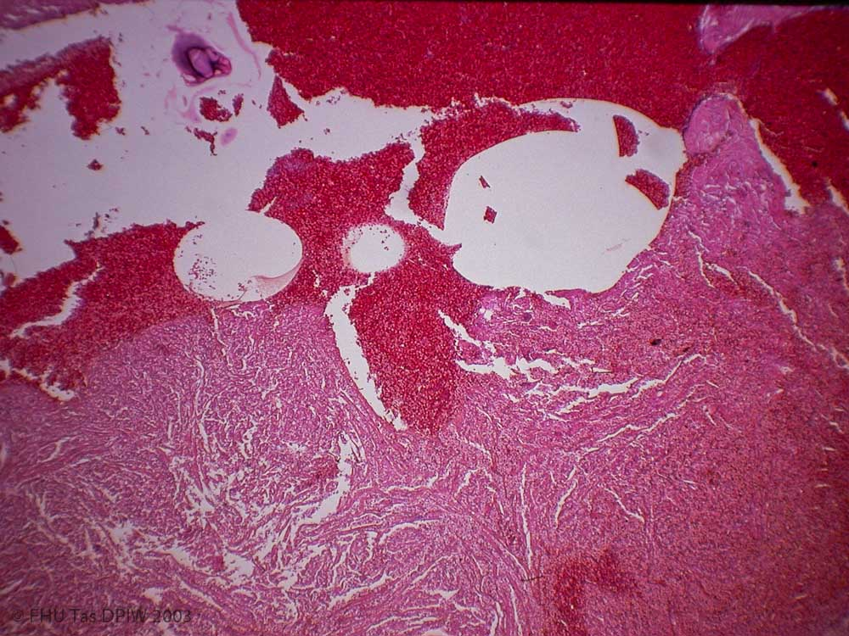
NON-INFECTIOUS INSULTS TO HEART 1. Gas bubble disease.
Large bubbles are sometimes easily missed, but are lethal as they are generally associated with smaller bubbles which block gill circulation. Obvious care needed to exclude agonal artifacts. This example was from a major gas bubble related fish kill.

Slide 27
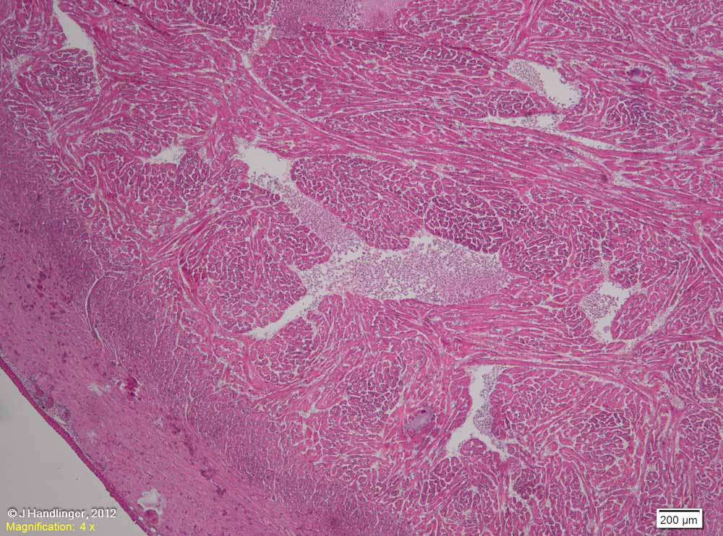
Non-infectious insults 2. Per-acute: fish pump gill damage.
Heart from the fish with severe haemorrhage & congestion of gills due to pressure after entering a fish pump backwards (see also gill presentation, non-infectious, for resulting gill lesions).
Higher magnifications show that there is both haemorrhage, mainly on the surface, and congestion, which in part would reflect the resulting impediment to blood flow through the gills. (This in turn may be a mixture of thrombosis associated with the haemorrhage, physiological vasoconstriction, and the direct effect of the pump pressure on gills unprotected by an open operculum and unable to pass through the tube if lodged sideways.)

Slide 28
Non-infectious insults 3. Aurelia jelly-fish exposure.
Heart of a young salmon exposed ~ 6 hours previously to small Aurelia jelly-fish, with typical gill, skin & mild liver lesions. Note the small area of compact muscle congestion (right, arrow), and the compact muscle pallor, relative to spongy muscle.
Such changes, though mild, were common with Aurelia jelly-fish exposure and may have contributed to the post-exposure shock. The pallor is clearly confined to the compact layer – which makes sense as the toxins are likely to have been absorbed through the damaged gills, with higher levels supplied to the compact muscle layer via the descending coronary arteries, compared to the post-venous blood supplying the spongy trabecular layer.

Slide 29
Non-infectious 4. Myonecrosis, sub-acute gill thrombosis related.
Such foci are are associated with vacuolation & / or necrosis of individual muscle trabeculae (arrows).
They are largely composed of what appear to be crenated cells.
Heart from a 3 kg rainbow trout from south-eastern Tasmania showing gill lesions highly suggestive of severe jelly-fish exposure of a few days to ~ 1 week duration (severe gill lamellar thrombosis showing early resolution; increased gill and circulating leukocytes). There was also mixed apparently secondary Flavobacterial infections of skin and gill.
The heart shows areas of congestion and possible haemorrhage in the compact layer, with reaction extending into the spongy layer (where the concept of haemorrhage or congestion is meaningless, given the blood flow).

Slide 30
Higher magnification, showing that one of the major components of the aggregate is hyper-segmented neutrophils. Neutrophil hypersegmentation is consistent with haematology findings post-jelly fish exposure, where large numbers of such cells can be expected a week or so following exposure (see Part 6, Haematology). It is not clear if this represents only normal aging of neutrophils that rapidly increased in the blood following such exposure, or whether neutrophil damage also occurs.
The trabecular muscle lesions suggest more circulating toxin in this fish than is common (focal congestion and poorly defined pallor, as above, being the major heart findings immediately following exposure). Direct damage may also have been compounded by circulatory consequences of gill damage, such as vasoconstriction.

Slide 31
Another field showing clots of crenated cells, some associated with necrotic muscle fibres.

Slide 32
Non-infectious 4. Distrophic calcification following gill fractures.
History: The primary lesion in this and several cohort fish was fractures of deformed and poorly calcified gills. These were a sub-set of 8-900 g rainbow trout, only recently moved to sea after a long freshwater phase. Though most fish were performing well, there was some increase in mortality, with several types of stress related presentations & distorted gills in ~ 30-40 % of dead or moribund fish.
Of the 6 lethargic or moribund fish examined with poorly formed distorted “moppy” gills, 3 showed fractures. These showed bone displacement, bone necrosis, little callus formation, and some healing by fibrosis. Of the 3 with gill fractures, 2 showed calcified foci in the heart and zone related liver changes (congestion & degeneration in 1; degeneration to necrosis in the other). Both of those with heart mineralization showed also occasional tiny foci of calcification in caecal epithelium, associated with bacteria.
The overall presentation was suggestive of disturbed calcium and or vitamin D metabolism, plus trauma, though no dietary or water composition history was available.
Another field from this slide, showing gill fractures, apparently of differing ages. [See Section 11B – gills, non-infectious, for gills from another fish from this cohort].

Slide 33
Heart, from above case, showing calcified foci (white arrows) and a few melanomacrophage centres (blue arrows), mostly at the compact: spongy junction. Heart morphology is otherwise normal to slightly thickened for this age group.
Liver from this fish. Liver pathology with such a zone related pattern in the 2 fish with extensive gill fractures, but not in others of this cohort, suggests a component of congestive heart failure associated with increased blood pressure consequent to resistance through the extensively damaged gills, possibly involving both mechanical effects and local vascular responses.

Slide 34
NEOPLASIA OF THE HEART
The heart, like any tissue, is occasionally subject to primary neoplasia, and is well positioned for metastases, as seen in this heart from a fish with skin melanomas (See Part 10B slides 100-101).

Slide 35
VASCULAR ODDITIES
An occasional finding in fixed sections, usually of small fish, is crystals within blood vessels (arrow). These appear to represent re-crystalization of haemoglobin after death and probably during fixation.
Fish haemoglobins are more variable than those of mammals, and while usually tetrameric like mammals and with high sequence homology to those of mammals, are often more rapidly disassociated, and have more variable side chains. Overall they autooxidize and release hemin ~50-100-fold more rapidly than those of bovines. These changes occur more rapidly at low pH, which may be a factor in development of this uncommon but sometimes startling fixation artifact.
Photographed with x10 objective.

Slide 36
Infectious diseases of heart & vessels
Many of the common systemic infectious diseases involve the heart, as well as small vessels throughout the body. As the pathology of these has generally been covered elsewhere, some examples only will be covered. (To maintain continuity with the gill infections, these will be examined in decreasing size order).
Several types of parasites, and a number of viruses, specifically target the heart.
Fortunately known viruses which target the heart and are commonly associated with heart pathology do not occur in Australia.

Slide 37
VIRAL INFECTIONS OF HEART.
Several viruses target heart muscle of salmonids in Europe, particularly Norway, causing major economic loss for decades. Evidence indicated each was viral related but relevant viruses have only been identified in recent years. At this time all are exotic to Australia.
1. Pancreas Disease (PD) [see Part 9C for pancreas lesions] commonly occurs with concurrent inflammation of heart, and later skeletal muscle. PD (and the related sleeping disease of rainbow trout) is now known to be caused by strains of a virus of the genus Alphavirus within the family Togaviridae (McLoughlin & Graham, 2007).
2. Heart & skeletal muscle inflammation (HSMI) causes focal lesions in heart & skeletal muscles in Atlantic salmon, 5-9 months after transfer to sea. It was recently confirmed (by a novel DNA sequencing method and in situ hybridisation, not culture), that HSMI is caused by a novel reovirus, not closely related to previous aquatic reoviruses, termed piscine reovirus (PRV), (Palacios et al, 2010).
3. Cardiomyopathy syndrome (CMS) is a severe chronic cardiac disease of large Atlantic salmon, mainly in Norway, recently shown to be due to a double-stranded RNA virus, named piscine myocarditis virus (PMCV), probably belonging to the Totiviridae family (Haugland et al, 2011).
This appears to be the first member of the Totiviridae to infect a vertebrate host. Most persistently and asymptomatically infect fungi & protozoa, (some infect arthopods – one causes myonecrosis in shrimp). Most Totiviridae can only infect new cells during cell division, though PMCV can be shed extracellularly.

Slide 38
1. Pancreas Disease (PD), Alphavirus infection
PD is seen in salmon from 110 g (3 weeks after transfer to sea) to 5-6 kg salmon, with the dominant lesion generally in the pancreas [see Part 9C ], and with heart & / or skeletal muscle lesions in ~78% of outbreaks.
As well as general wasting & no caecal fat, this chronically affected fish shows pale patches in the fillets (skeletal muscle).
These & following photos of heart virus diseases courtesy Hamish Rodger Vet-Aqua International, Oranmore, Co. Galway, Ireland. Not to be reproduced without permission.

Slide 39
Pancreas Disease (PD) continued: Major microscopic lesions in the heart (ventricle, atrium) & skeletal muscles are focal coagulative necrosis with loss of striation, increased eosinophilia and granular and vacuolar changes, with myocardial myocytic nuclear hypertrophy in recovery phase.
Myocardial lesions (below), including inflammation & degeneration.
Skeletal muscles show multifocal areas of myodegeneration and phagocytosis of fibre remnants, leaving, as in this slide, scarring between remaining fibres which grossly appears white.
Experimentally infected fish at 28 day post infection showed endocardial cell proliferation and mononuclear cell infiltration, particularly at the junction of the compact and spongy cardiac ventricular muscle, sometimes epicarditis.
Minor lesions can occur in other organs such as or focal brain gliosis, or cells fill with eosinophilic granules in the kidney.
PD occurs in Atlantic salmon in Scotland and Ireland, & in Atlantic salmon and sea reared trout in Norway. The related Sleeping Disease of rainbow trout fry (mainly a heart and skeletal muscle disease), is seen France, England, Scotland, Germany, Italy, and Spain. All are caused by three (or more) related salmonid Alphaviruses (SAV 1, 2, 3), though some sub-groups within these have recently been found.

Slide 40
2. Heart & skeletal muscle inflammation (HSMI), piscine reovirus
In HSMI there are focal lesions in heart & skeletal muscles, particularly red skeletal muscle. There are no pancreas lesions . Morbidity is high, and mortality up to 20%.
Macroscopically there is a pale flabby heart with loose texture, pericardial haemorrhage, ascites. Liver may be pale, jaundiced or blood filled. There may be spenomegaly & petechiae in adipose tissues. Haematocrit is usually normal.
As well as Norway, HSMI has been seen in Scotland (though some of the initial reports in Scotland were possibly confused with pancreas disease Alphavirus infection), and in Chile, with recent unconfirmed reports in Canada.
In Norway the virus can be found in other species (Atlantic herring, mackerel and smelt), (Biering & Garseth, 2012).

Slide 41
HSMI continued: The main lesions of HSMI are necrosis of muscle fibres and a massive inflammatory response (mainly mononuclear) involving, in the heart, both compact and spongy layers of the ventricle. Earliest changes were inflammatory cells lining vessels of the compact layer and endocardium. An extensive epicarditis is often present (lower right).
HSMI lesions in skeletal muscle.

Slide 42
3. Cardiomyopathy syndrome (CMS), infection with PMCV, Totiviridae
Cardiomyopathy syndrome (CMS) is characterized by a necrotizing myocarditis involving the atrium (first photo) and the spongious part of the ventricle (second photo) following massive focal mononuclear cell infiltration. Skeletal muscle is not affected.
Though typical histological changes can be reproduced experimentally within 6 weeks, the disease may develop over several months before reaching the clinical phase at ~ 14-18 months after transfer to sea (typically second summer at sea close to harvest & in brood stock).

Slide 43
Cardiomyopathy syndrome (CMS) continued:
Gross lesions & clinical signs reflects chronic heart failure, often resulting in petechia & multifocal liver necrosis. Generalized signs of disease such as skin congestion & oedema, & occasionally exopthalmia, may be present (Rodger et al, 2013).
Affected fish may die suddenly without prior clinical signs, with blood in the pericardial sac (cardiac tamponade), & moderate to pronounced ascites.
The virus (PMCV, Totivirus, double stranded RNA) is present almost exclusively in myocardial lesions, and persists, testing positive at 33 weeks post challenge. This is despite the massive leukocyte infiltrate that included T & B lymphocytes and macrophages.
The virus has also been reported in wild migrating Atlantic salmon.

Slide 44
BACTERIAL INFECTIONS OF HEART.
Example 1. Acute Yersinia ruckeri septicaemia.
Heart atrium of this fish showing an overall foamy appearance.
Spleen and kidney of a 200g salmon with acute Y. ruckeri infection following transport stress. The depletion of spleen ellipsoids & renal interstitia, and recruitment of macrophages to ellipsoid cuffs are typical of the acute responsive stage of the infection (see Parts 2 & 5).

Slide 45
Higher magnification of the atrium, showing an overall foamy appearance of the abundant mural reactions, though vacuolation is also present in some myocardium.
Detail of the myocardial vacuolation, the large number of reactive surface macrophages, and several foci of degenerate cells (arrow). Such mural reactions reflect the reticulo-endothelial content of the atrial endothelia.

Slide 46
The ventricle of this fish shows much less change, though there is scattered vacuolation through the myocardium and round vessels, plus mild congestion (visible in this photo only at far right).
[Note the ventricle of this fish is thicker than normal, an apparent earlier physiological response. This has reduced the interaction of blood with ventricular surfaces, which do contain RE cells, but fewer than in atria.]
Detail of the dense: spongy junction (arrowheads) showing the reduced lumen space. With normal trabecular proportions this is often a site of bacterial entrapment, at the margins of blood flow.

Slide 47
[Example 1b. Another acute Yersinia ruckeri septicaemia (for anatomical comparison).]
Compare the previous heart with the poor thin heart of this fish, which also has acute Y. ruckeri infection. The reduced musculature better demonstrates the dense / spongy junction as entrapment sites, and the natural blood flow pattern towards these sites.

Slide 48
Back to 1a: Detail of an intravascular reaction: similar to those elsewhere in the body.
Outbreaks of yersiniosis are relatively common following transport (at least in unvaccinated fish), as residual sub-clinical infection often follows hatchery outbreaks and are re-activated following the combined stress of transport and change to a more marine environment.

Slide 49
Bacterial example 2. Acute Yersinia ruckeri septicaemia 2.
As with any infection, the pathology can vary with the stage of infection, the virulence of the strain, and the competency of the host.
This group of salmon also showed increased mortality following transport to sea, including specific problems during transport that increased stress levels. This fish showed the highest level of bacteraemia, and marked congestion & slight oedema in spleen (below).

Slide 50
The heart of this fish shows hyperaemia and haemorrhage of the ventricular wall (also uncommon). Note that this fish also showed increased myocardial thickness (hypertrophy), presumably reflecting prior circulatory effort.
Details of the myocardial lesion.

Slide 51
Bacterial example 3. Aeromonas salmonicida infection in an Atlantic salmon.
A colony of marine atypical A. salmonicida (atypical A.salmonicida bv acheron), in the myocardium of a maturing female salmon from the West Coast region of Tasmania.
Detail: Note the dense clumps (microcolonies) , indicative of a non-motile bacterium, typical of this species, and the lack of host reaction. (Hosts with clumps such as these would usually die of toxaemia before a reaction is mounted).
Aeromonas salmonicida are also known to produce strong leucocidins which destroy leucocytes which further impedes an flammatory cell response in the acute disease.

Slide 52
Bacterial example 4. Aeromonas salmonicida infection in a greenback flounder.
Multiple microcolonies of marine atypical A. salmonicida (biovar acheron) in the myocardium of a greenback flounder, Rhombosolea tapirina.
As seen previously in the spleen (Part 5), greenback flounder were able to mount a response to this strain (not always successfully). One site is similar to the above, with bacterial proliferation without obvious reaction (white arrow). Two others in this field show a host reaction, as well as fibrin associated with tissue degeneration – also an indication of a more prolonged course than seen in the salmon (pink arrows).

Slide 53
Bacterial example 5. Streptococcus iniae infection of barramundi myocardium.
Details of the mixed reaction.
The bacteria are generally within macrophages, despite the mixed reaction.
S. iniae was visible also in gills and other vessels of this fish.
Localisation of bacteria, often with chronic infections, in serosa and / or meninges, is typical of gram positive infections such as S. iniae, Lactococcus garvieae, Vagococcus salmoninarum, and Carnobacterium piscicola, all of which can show lesions in multiple organs during the septicaemic phase.
Meningitis is common with both S. Iniae & L. garvieae. Chronic peritonitis, often extending to pericarditis, is particularly common following L. garvieae septicaemia, and is also seen with V. salmoninarum, and C. piscicola. In some cases, retrograde peritoneal infection at the time of egg stripping was suspected. Deaths during generalised septicaemia of the latter two bacteria were uncommon.
Localisation of bacteria within specific tissues is a common consequence of the initial septicaemic phase for many bacteria, sometimes leading to localised chronic infections.
This sub-acute infection shows inflammation extending well beyond the nidus of bacterial proliferation (arrow).
Photographed from Aquatic Slide of the Quarter (Apr-Jun 06), distributed by Gribbles.

Slide 54
Bacterial example 6.
Gram positive bacterial peritonitis & pericarditis.
Two rainbow trout with mixed Carnobacterium & Vagococcus infection
Ovary
Heart
Spleen

Slide 55
Bacterial example 7. Chronic pericarditis with steatitis and focal myocarditis. Salmon.
The myocardium is largely unaffected.
... other than the single focus of myocarditis.
While occasional cells containing bacteria appear to be present in the active surface layer (arrow), the bacteria were not identified as the heart surface was not cultured. The group was experiencing increased mortalities with gill and skin lesions following high temperatures and algal blooms, and had a history of yersiniosis. No bacteria were recovered from kidney, other than unidentified Vibrio sp. in the kidney of this fish – an unlikely candidate for these lesions, especially as similar lesions were seen in other fish from this group which were negative on kidney culture. It is possible that this typical chronic pericardial infection was restricted to this organ and therefore not recovered in kidney culture, underlying the need to culture grossly affected organs as well those most suitable to detect systemic infections.

Slide 56
FUNGUS-LIKE INFECTIONS: Ichthyophonus in heart.
Example 1. This is the heart of a rainbow trout with Ichthyophonus infection. High levels of this organism were also found also in gills (see also Part 11C), gut, liver & kidney. The abundant pigment, derived from melanomacrophages, is an indication of the duration, as well as intensity of the reaction.

Slide 57
Example 1 continued:
However macrophage dominant reaction is also present around live bodies.
Reaction intensity is varied, being greatest around remnant Ichthyophonus bodies.

Slide 58
Example 2:
Division within one capsule.
Another rainbow trout, same region, with both successful host reactions / dead Ichthyophonus, and active division of the pathogen.

Slide 59
Example 2:

Slide 60
Example 3: Another rainbow trout from the same area. There is little reaction within the ventricular myocardium, but considerably more around the remnant capsule in the spongy atrial myocardium which, as shown previously, is well supplied with potential macrophages lining the trabeculae.

Slide 61
PARASITES OF THE HEART.
1. Adult blood flukes in heart lumen.
Blood flukes are an emerging problem in marine culture species, including tuna and barramundi. Usually adults live within the heart causing little pathology, though this varies with species and intensity of infection. Some adults adhere to smooth surfaces such as vessel walls by suction, others possess lateral tegumental spines and / or embed themselves in the wall of the heart. Eggs usually pass to the gills, but some may lodge within the heart vessels / muscle. Some hosts (for example, carp) show a marked response to both eggs and adults involving eosinophils, neutrophils, macrophages (Bullard and Overstreet, 2002)
Pathology associated with Sanguinicolid blood fluke eggs is covered with the gill.
Adult Cardicola forsteri fluke from southern bluefin tuna heart.
Granuloma surrounding an egg of C. forsteri.
Photos from Nowak et al, 2006 (Southern Bluefin Tuna Health, AquafinCRC), with permission.

Slide 62
2. Encysted / encapsulated fluke in wrasse.
Heart from an archive (1990) case listed as “blue wrasse” (possibly the blue throated wrasse).
One live parasite shows characteristics suggestive of encapsulated flukes (or possibly cestodes?) (arrow).
Section of this heart, showing multiple reactions to dead and live parasites.
The parasites were not identified. Could this be another blood fluke?
Factors against this include the site of the parasites (most adult blood fluke are within the lumen – though some can be embedded). They don’t fit either the size or morphology of developing eggs, which can also elicit a strong response.
However sanguinicolid blood flukes are common in wrasse species, with a new species recently described from this fish group in Tasmanian and Western Australian waters (Nolan & Cribb, 2005)
Pilchards from a Tasmanian kill

Slide 63
Fluke in wrasse heart continued: Note that despite the obvious long-standing reactions, and the considerable heart tissue involved, there is no indication of a compromise of heart function.
Pilchards from a Tasmanian kill

Slide 64
3. Burrowing copepods. Chronic granulomatous lesions in the ventricle, major vessels or bulbus arteriosus should prompt consideration of burrowing copepods. Examples: below (left) is the projecting rear of a female Lernaea copepod from a Murray cod (freshwater “anchor worms”), showing the typical copepod double egg sacs. The anterior parts are deeply embedded in soft tissues (usually muscle, rarely heart, kidney in some species).
The 2 blood engorged “cod worms” Lernaeocera branchialis (right) on the gills of whiting are also female copepods with long coiled egg sacs and similar lifestyle. They have a small feeding tube extending along vessels generally to the bulbus arteriosus or ventricle (sometimes just in gill vessels). Adult females of this species are among the largest of the copepods (> 40 mm). Adult L. branchialis infect cod or other gadoids, but a juvenile stage parasitizes other fish such as flounder. They are blood feeders, and elicit a granulomatous response around the holdfast.
Pilchards from a Tasmanian kill

Slide 65
4. Nematodes in the heart. Heart from sleepy cod Oxyeleotris lineolatus, showing abundant nematodes within the heart atrial cavity. (Ql’d case, courtesy R. Chong & DAFF, Qld.)
Nematode body wall and filaroid larvae visible at higher magnification.
Nematode body wall and fine larvae are visible at higher magnification.
So finding similar worms in the aorta (ventral to the spinal chord), should not be unexpected?
Though as these are also adults, and the gills and peripheral circulation both pose a bar to direct transfer from the heart, either:
a) They have matured from larvae shed by adults in the heart (larval stages where?), or vice versa.
b) Both were derived from larvae entering the body elsewhere.
Notochord
The nematodes were not identified in this case. The heart / vessels are not common sites for nematodes, but many of the Anasarkid like group have a wandering habit that could involve vessels, with some species such as Contracecum microcephalum occurring in the atrium of fish such as flatheads, and Philonema saltatrix causing heart and pericardial cavity inflammation in in Polmatomus saltatrix (Tailor or bluefish). The major eel pathogen Anguillicoloides crassus (formerly Anguillicola), which has been called the most aggressive fish parasite to have been translocated, actually lives mostly within the swim bladder but feeds from swim bladder blood vessels, which become very dilated.
Major pathology can be associated with nematodes within blood vessels.
Spinal
chord

Slide 66
5. Phagocytosis of circulating parasites: example – guppy myxosporea.
Heart of a guppy (Poecilia reticulata), with circulating (pre-spore) forms of a Sphaerosphora like myxosporean, showing increased phagocytic activity, especially in the atrium (upper right).
Warthin-Starry stain, atrium, same block. Large numbers of these parasites have pooled within the atrial clot. They are the small pale cells near the arrow and between the darkly stained elliptical erythrocytes. Others are present within the reticulo-endothelial reactions lining the trabeculae.
Another field, same section. Note the parasites within phagocytes (white arrow), and free in the lumen (blue arrow). Phagocytes are particularly abundant on atrial surfaces (x 40 objective magnification).
Same blocks, H&E stain (x 100 objective), showing detail of the parasites, with 1 to 2 (occasionally more) nuclei in dividing forms.

Slide 67
INFECTIONS AND PERIPHERAL VESSELS.
Example 1: septicaemias (bacterial & viral). Remember that damage to minor vessels is one of the primary lesions in many systemic bacterial & viral infections. (Such lesions have generally been covered with the organ systems.)
Acute Yersinia ruckeri
Aeromonas salmonicida
Viral haemorrhagic septicaemia (VHS)
http://en.wikipedia.org/wiki/Viral_hemorrhagic_septicemia
Aeromonas salmonicida

Slide 68
Example 2: ISA. Infectious salmon anaemia virus (ISAV), a virus of endothelial cells.
ISA receptors line blood vessels of Atlantic salmon, on endothelial cells & erythrocytes (Aamelfot et al, 2012), resulting in disrupted blood flow and anaemia. We have previously looked at resulting lesions in kidney & liver, apparently due to microvascular damage (Parts 4 and 9C).
Canadian salmon gill with ISA induced central vascular congestion (in contrast to the lamellar congestion seen with many water borne insults). The uniformity suggests this may be due to the disturbances of vascular flow, rather than local vacuolar damage.

Slide 69
Infection & peripheral vessels 3. Disseminated intravascular coagulation (DIC).
DIC has been perhaps best studied in the exotic “Hitra” disease (cold water disease), a haemorrhagic disease of salmonids caused by Vibrio salmonicida (now Alliivibrio salmonicida), but similar findings can occur in other septicaemias (Salte et al, 1987; Bruno et al, 1996; Urbanczyk et al, 2007).
V. salmonicida infections occur almost exclusively in Atlantic salmon in seawater, but have been reported in rainbow trout. They generally occur at temperatures of ~ 7ºC, and have been most widespread in northern Norway, though reported in Scotland, Northern America and the Faroe Islands. In Norway this disease is now largely controlled by vaccination. [Not seen in Australia.]
Affected fish exhibit haemorrhages and oedema in a number of organs, including petechiation over the gastrointestinal tract and visceral fat. Microscopically they show mural degeneration and necrosis, and eosinophilic intravascular clots, haemorrhage.

Slide 70
Infection & peripheral vessel 2. DIC continued: Below is an example of a DIC like reaction in the liver of an Atlantic salmon with acute yersiniosis.

Slide 71
References-heart & vessels
Re heart & vessel anatomy & function:
Evans, D.H. and Claiborne, J.B. 2005. The Physiology of Fishes 3rd Edition. Taylor and Francis CRC.
Ferguson, H.W. 2006. Systemic Pathology of Fish – A Text and Atlas of Normal Tissues in Teleosts and their Responses in Disease, pp141-142. Scotian Press.
Brill, R. W. & Bushnell, P.G. 1991. Metabolic and cardiac scope of high energy demand teleosts, the tunas. Canadian Journal of Zoology, 1991, 69 (7): 2002-2009, 10.1139/z91-279.
Nowak, B., Johnston, C., Hayward, C., Aiken, H., Adams, M., Evans, D., Deveney, M., Carson, C., Jones, B., Evans, R., Dyková, I., Porter, M., Naeem, S., Kruesmann, M., Bayly, T. & Pitney, C. 2006. Southern Bluefin Tuna Health. (AquafinCRC, on disc) B Nowak (Ed). University of Tasmania. ISBN 978-1-86295-374-1
Poppe, T.T. and Taksdal, T. 2000. Ventricular hypoplasia in farmed Atlantic salmon Salmo salar. Diseases Of Aquatic Organisms, 42: 35–40.
Bell J.G., McVicar A.H., Park M.T. & Sargent J.R. 1991 High dietary linoleic acid affects the fatty acid compositions of individual phospholipids from tissues of Atlantic salmon, Salmo salar: association with stress susceptibility and cardiac lesion. Journal of Nutrition 121, 1163–1172.
Seierstad, S L, Poppe, T T, Koppang, E O, Svindland, A, Rosenlund, G, Frøyland, L and S Larsen. 2005. Influence of dietary lipid composition on cardiac pathology in farmed Atlantic salmon, Salmo salar L. Journal of Fish Diseases 28, 677–690.
Farrell A.P. (2002) Coronary arteriosclerosis in salmon: growing old or growing fast? Comparative Biochemistry and Physiology 132A, 723–735.
Poppe, TT, Taksdal, T and Bergtun, PH. 2007. Suspected myocardial necrosis in farmed Atlantic salmon, Salmo salar L.: a field case. Journal of Fish Diseases 30, 615–620.

Slide 72
References-heart & vessels
Re viruses affecting heart
McLoughlin M F, Graham D A. 2007. Alphavirus infections in salmonids-a review. J Fish Dis. 30(9):511-31.
Palacios G, Lovoll M, Tengs T, Hornig M, Hutchison S, et al. (2010) Heart and Skeletal Muscle Inflammation of Farmed Salmon Is Associated with Infection with a Novel Reovirus. PLoS ONE 5(7): e11487. doi:10.1371/journal.pone.0011487
Haugland O., Mikalsen A.B., Nilsen P., Lindmo K., Thu B.J., Eliassen T.M., Roos N., Rode M. & Evensen O. (2011) Cardiomyopathy syndrome of Atlantic salmon (Salmo salar L.) is caused by a double-stranded RNA virus of the Totiviridae family. Journal of Virology 85, 5275–5286.
Biering, E. and Garseth, Å. H. 2012. Heart and skeletal muscle inflammation (HSMI) of farmed Atlantic salmon (Salmo salar L.) and the associated Piscine reovirus (PRV). ICES Identification Leaflets for Diseases and Parasites of Fish and Shellfish. Leaflet No. 58. 6 pp. http://info.ices.dk/products/fiche/Disease/2006/Sheet%20no.%2058.pdf
Rodger, H D, McCleary, SJ, and Ruane, N M. 2013. Short communication: Clinical cardiomyopathy syndrome in Atlantic salmon, Salmo salar L. Journal of Fish Diseases ?? doi:10.1111/jfd.12186.

Slide 73
References continued
Re Hitra disease:
Salte, R, Nafstad, P and Asgard, T. 1987. Disseminated Intravascular Coagulation in “Hitra Disease” (Hemorrhagic Syndrome) in Farmed Atlantic Salmon. Vet. Pathol. 24:378-385.
Bruno, DW. 1996. Cold Water Vibriosis Caused by Vibrio salmonicida. Aquaculture Information Series No 15. http://www.scotland.gov.uk/Uploads/Documents/15_1996.pdf
Urbanczyk H, Ast JC, Higgins MJ, Carson J, Dunlap PV. 2007. Reclassification of Vibrio fischeri, Vibrio logei, Vibrio salmonicida and Vibrio wodanis as Aliivibrio fischeri gen. nov., comb. nov., Aliivibrio logei comb. nov., Aliivibrio salmonicida comb. nov. and Aliivibrio wodanis comb. nov. Int J Syst Evol Microbiol December 2007 57:2823-2829; doi:10.1099/ijs.0.65081-0
Re re heart parasites:
Nolan, M.J & Cribb, T.H. 2005. Sanguinicola maritimus n. sp. (Digenea: Sanguinicolidae) from Labridae (Teleostei: Perciformes) of southern Australian waters. Systematic Parasitology 61 (2): 99-106.
SA Bullard, SA and RM Overstreet, RM. 2002. Potential pathological effects of blood flukes (Digenea: Sanguinicolidae) on pen-reared marine fishes. http://digitalcommons.unl.edu/cgi/viewcontent.cgi?article=1423&context=parasitologyfacpubs
Re vascular disease:
M. Aamelfot, O. B. Dale, S. C. Weli, E. O. Koppang, K. Falk. 2012. Expression of the Infectious Salmon Anemia Virus Receptor on Atlantic Salmon Endothelial Cells Correlates with the Cell Tropism of the Virus. Journal of Virology, 86 (19): 10571 DOI: 10.1128/JVI.00047-12

Slide 74
End of Part 11 (Circulatory System), Section A, Heart & vessels.

